Slide 1

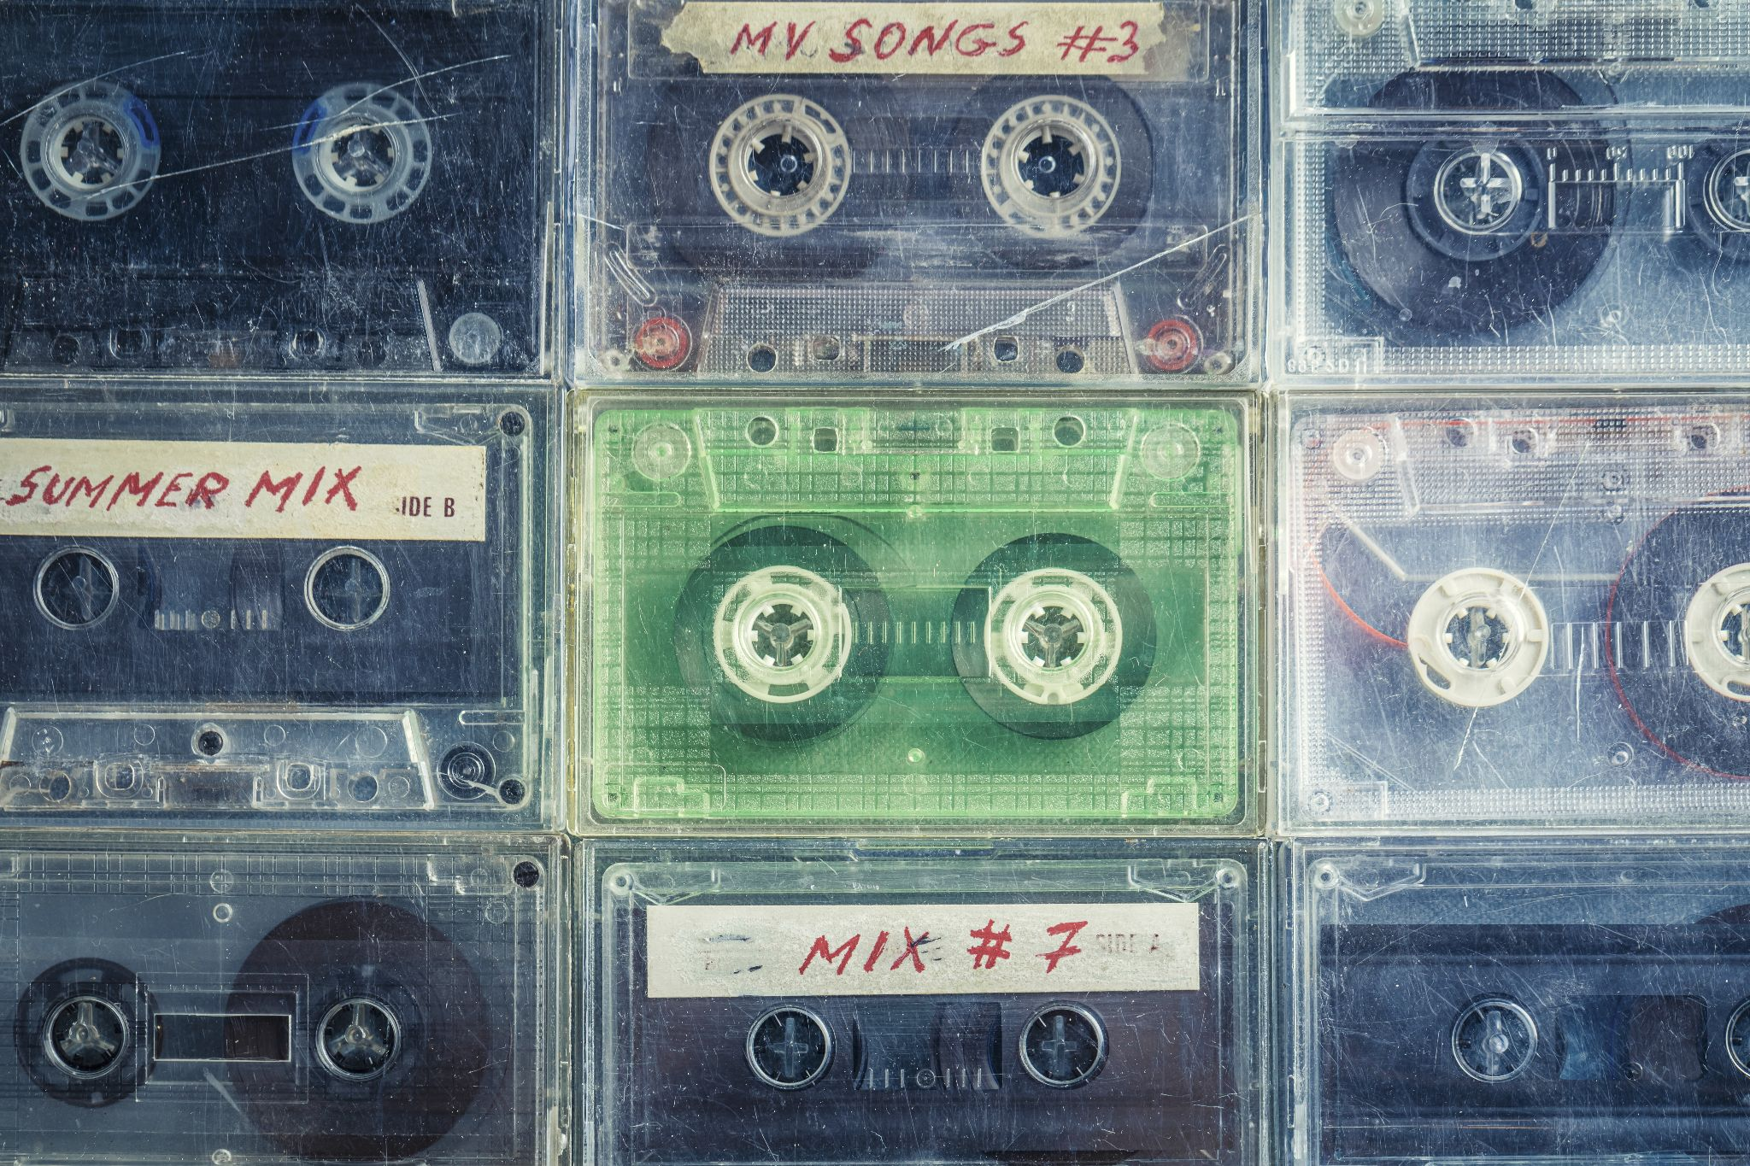

1
MemRemix
Where music and memories mix
Stanford CS194H Winter 2024

Slide 2


2
Remember these?

Slide 3
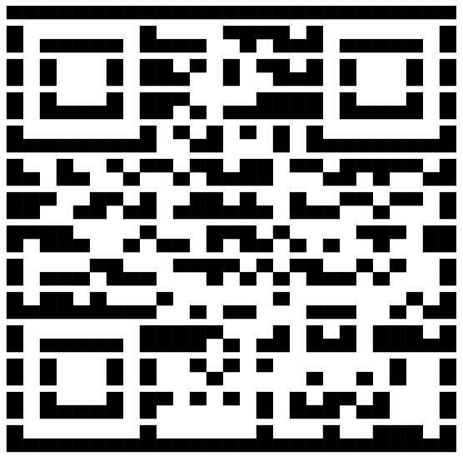
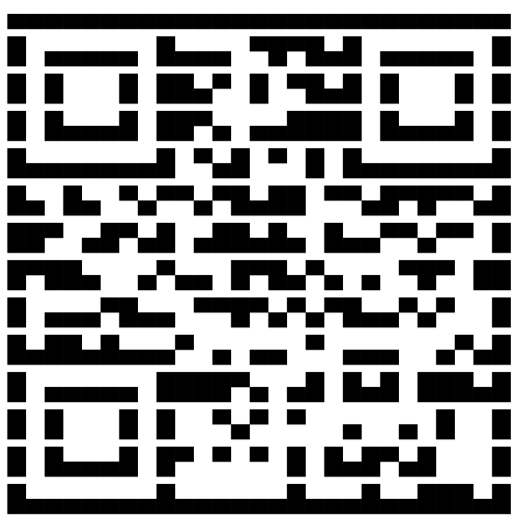
4
Outline
1
Problem and solution
2
Design evolution
3
Tasks
4
Implementation
5
Demo
mayannw@stanford.edu
123456
6
What’s next
Notes:
Emily - Tasks

Slide 4

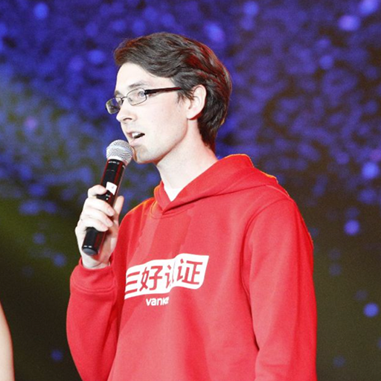
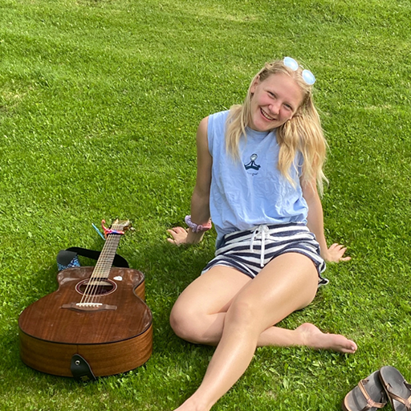

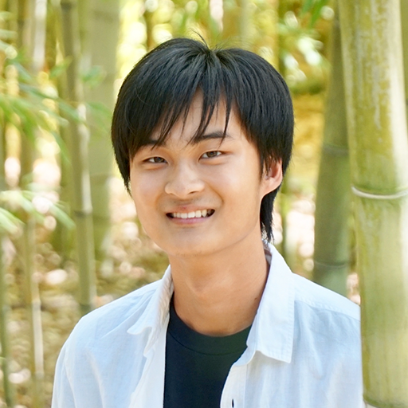
23
Our Team
Casey N.
Developer
Brent J.
Designer Developer PM
Emily R.
Designer Developer PM
Gray W.
Designer Developer
Tristan W.
Designer Developer
Notes:
Brent - Future work

Slide 5

5
Problem
For Em
We’ve lost the days of handcrafted mixtapes…
Music embedded with meaning and memories.
For Meg
For Jordan
mayannw@stanford.edu
123456
For Lily
Notes:
Emily - Problem / Solution
COMPETITORS - Spotify and Apple Music have collaborative playlists but published research in CHI has shown that these features are not socially fulfilling on their own for their users

Slide 6
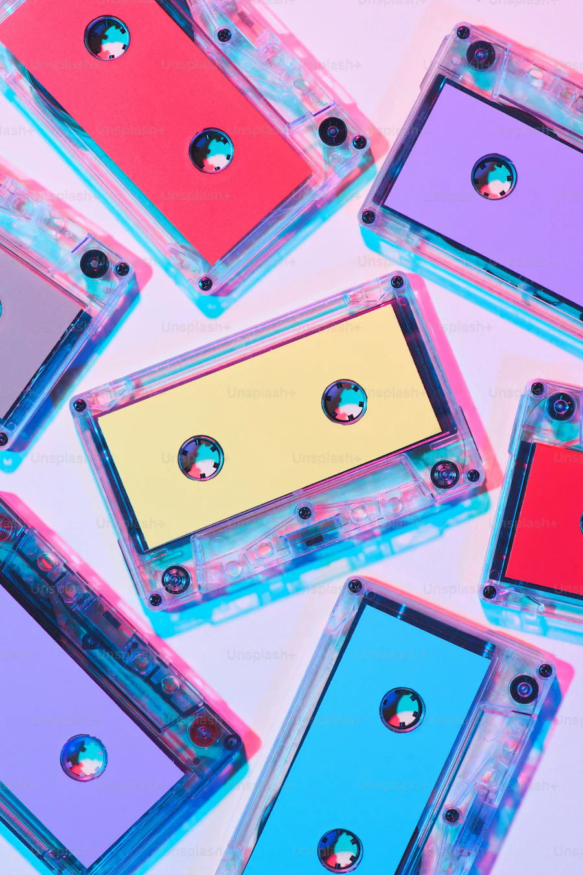
6
Solution
For Em
Memremix: a social music app where users can:
Gift and receive mixtapes
Revisit music memories
Explore community music
For Felix
For Meg
For Jordan
mayannw@stanford.edu
123456
For Lily
Notes:
Emily - Problem / Solution

Slide 7

7
Design Evolution

Slide 8
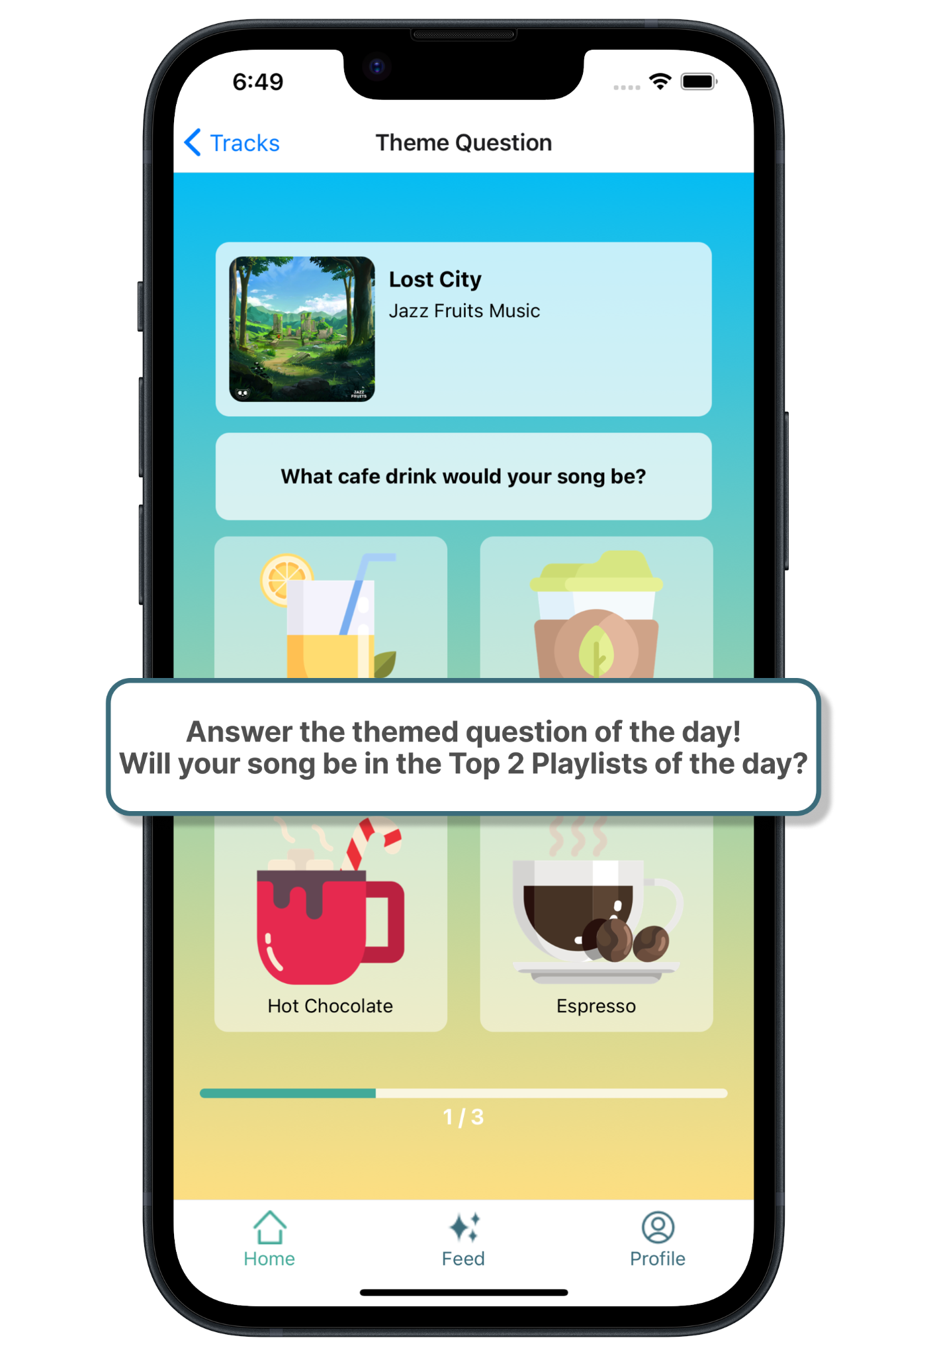
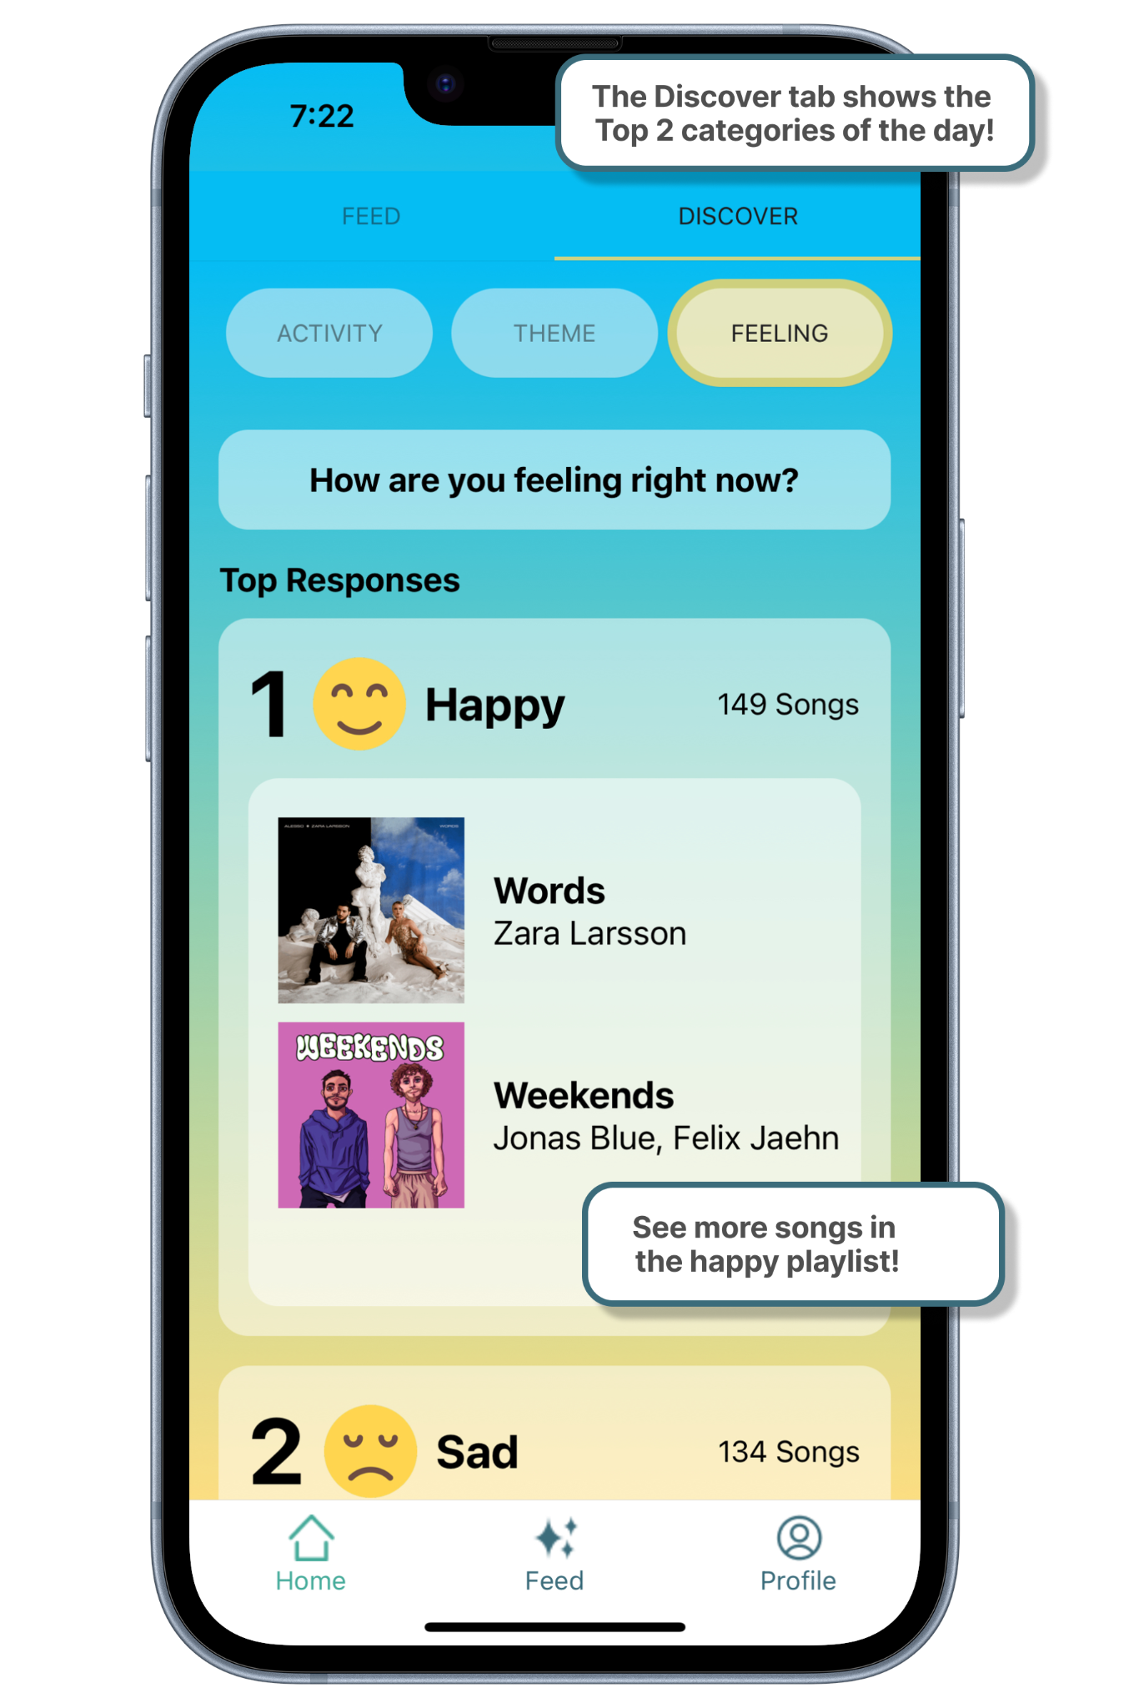
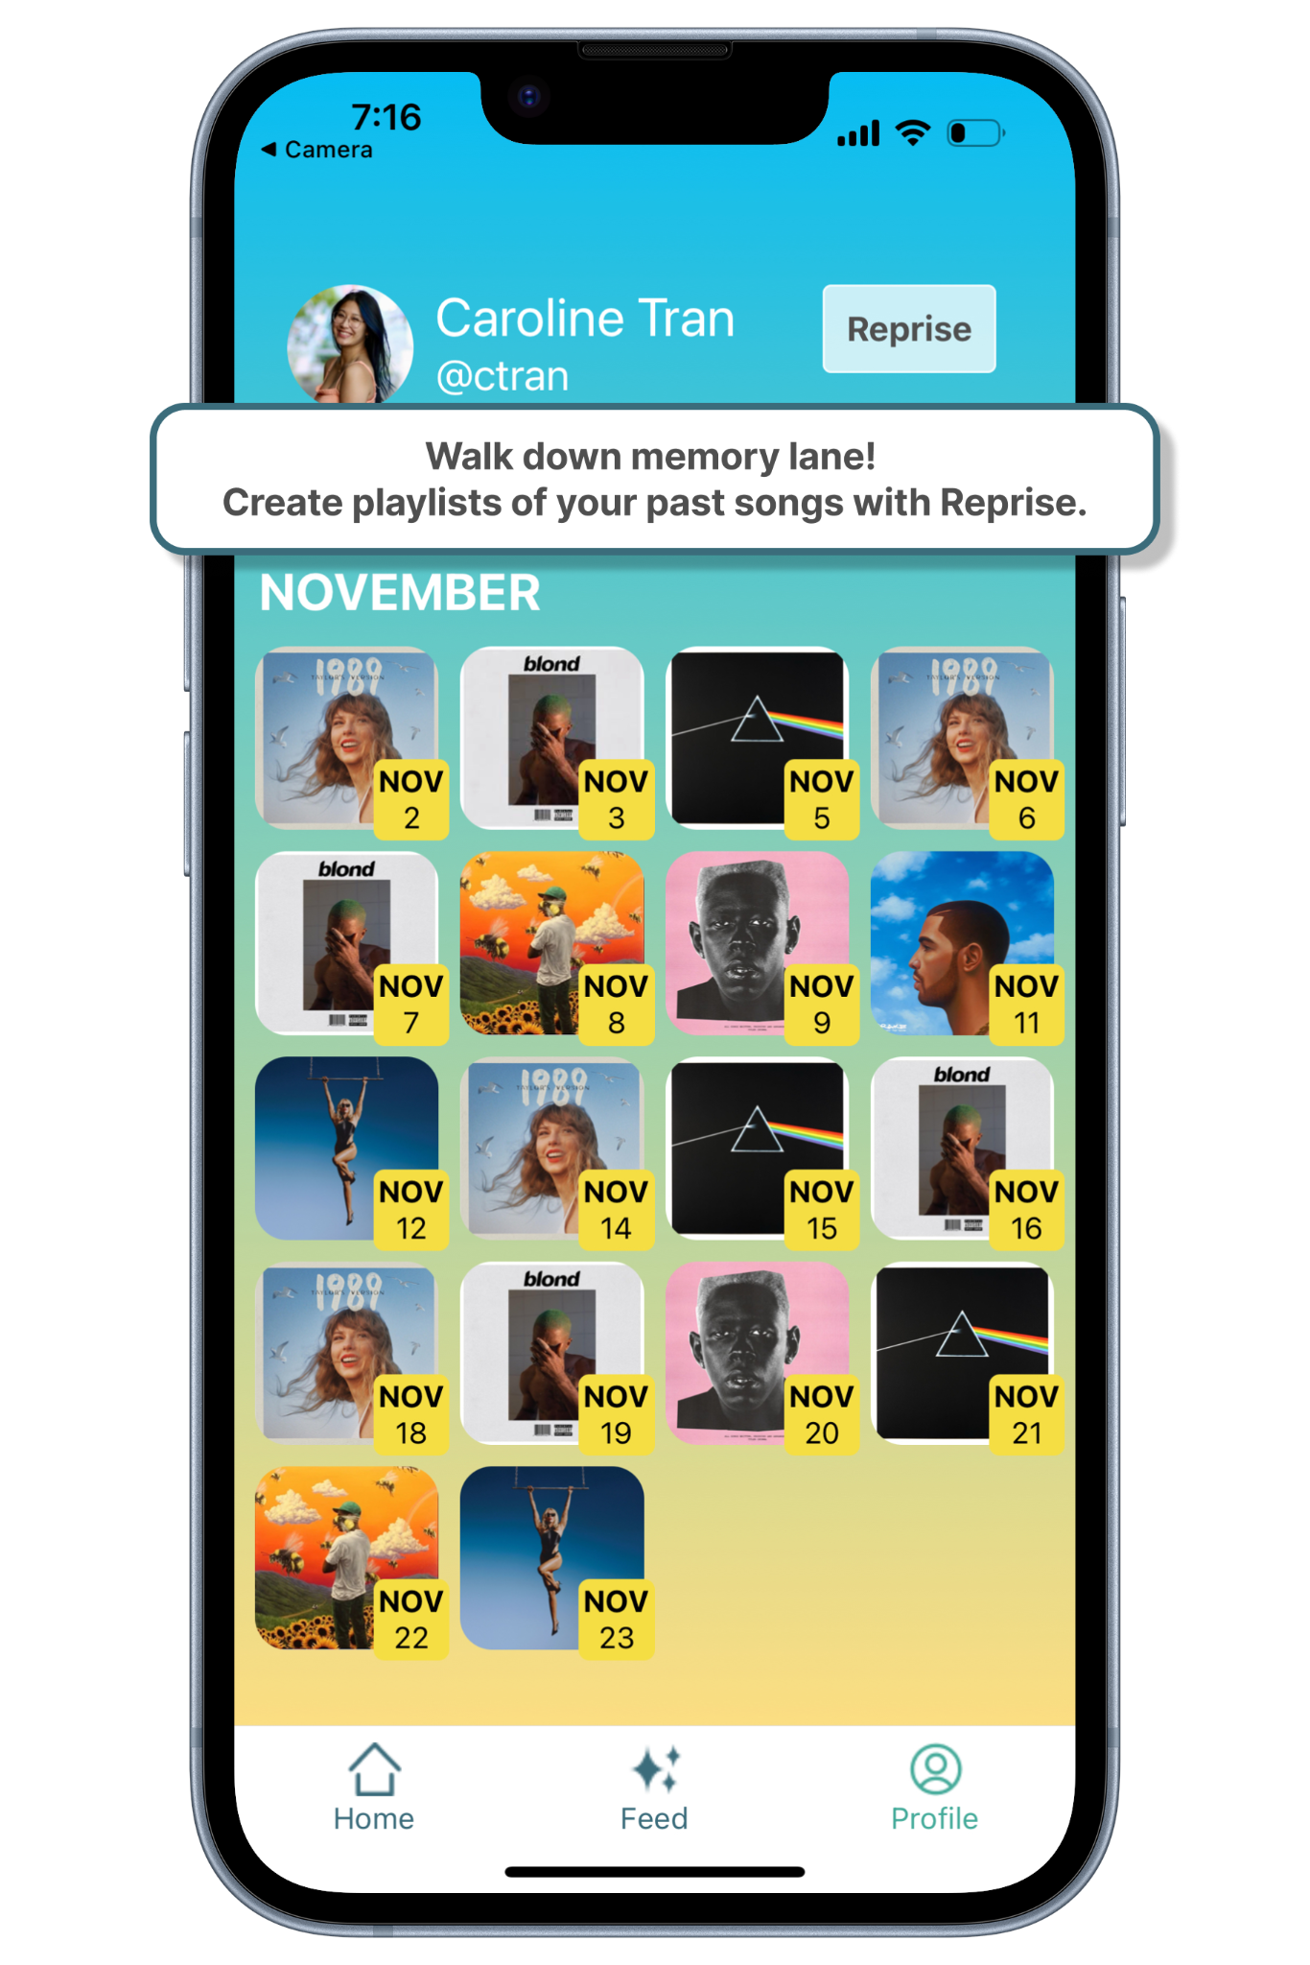
8
V1: How it started…
MemReprise (V1) centered around individual
music reflection
Notes:
Emily - Evolution

Slide 9
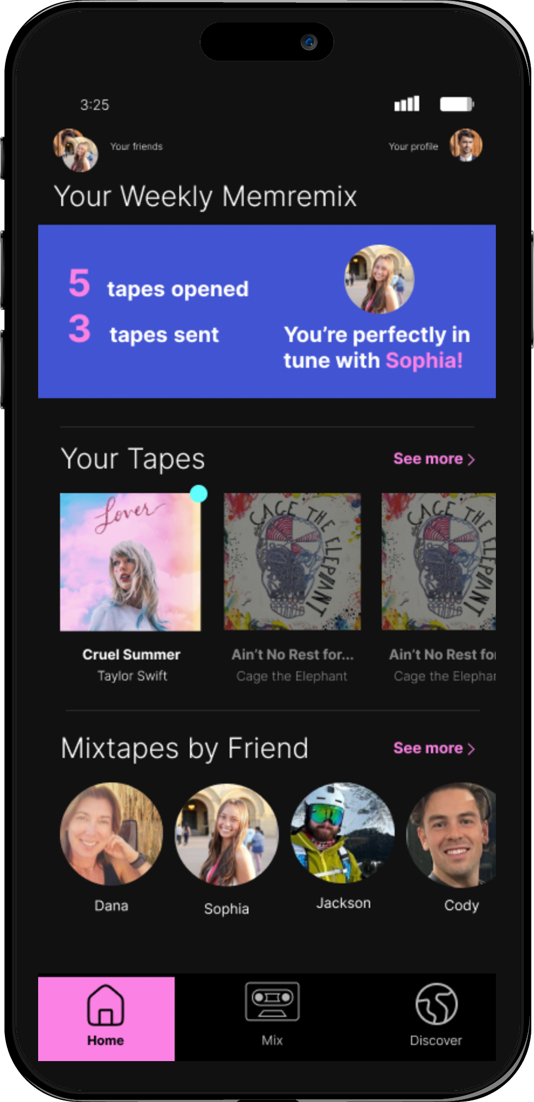
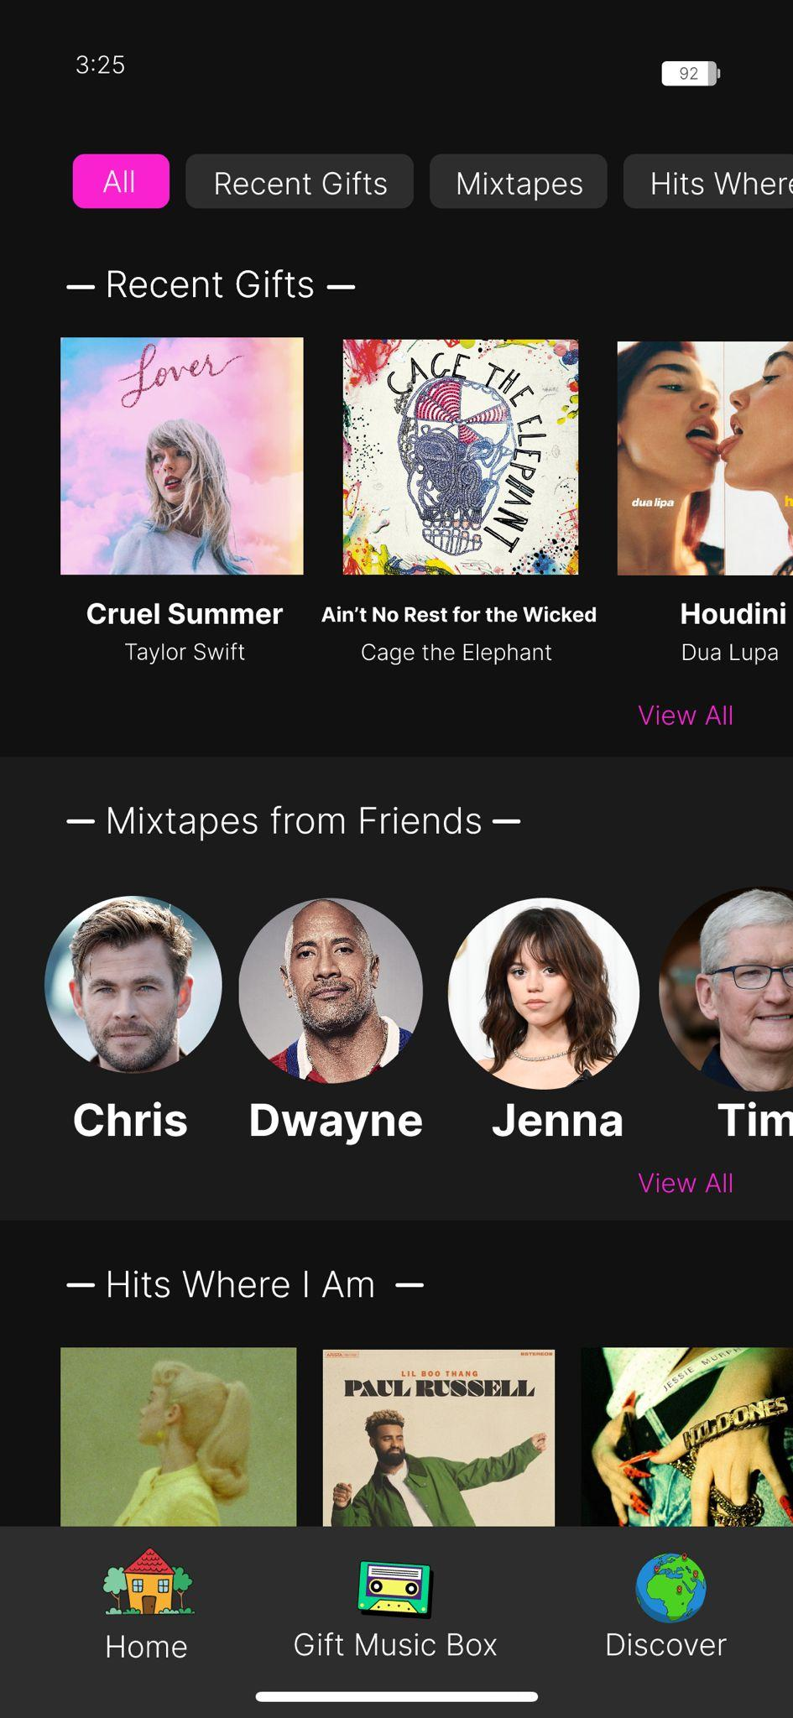
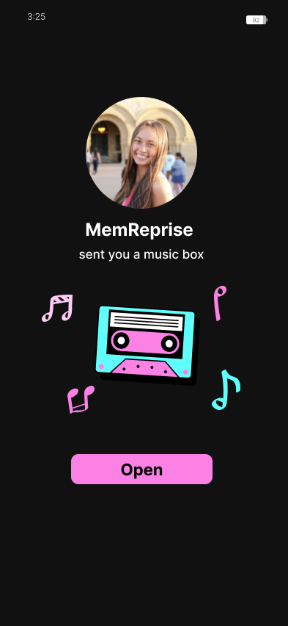
9
V2: Memreprise to MemRemix
MemRemix (V2) pivoted to social mixtapes
But still room for design improvement… how do we make
“Modern day mixtapes” ?
Notes:
Emily - Evolution
Mention user testing

Slide 10

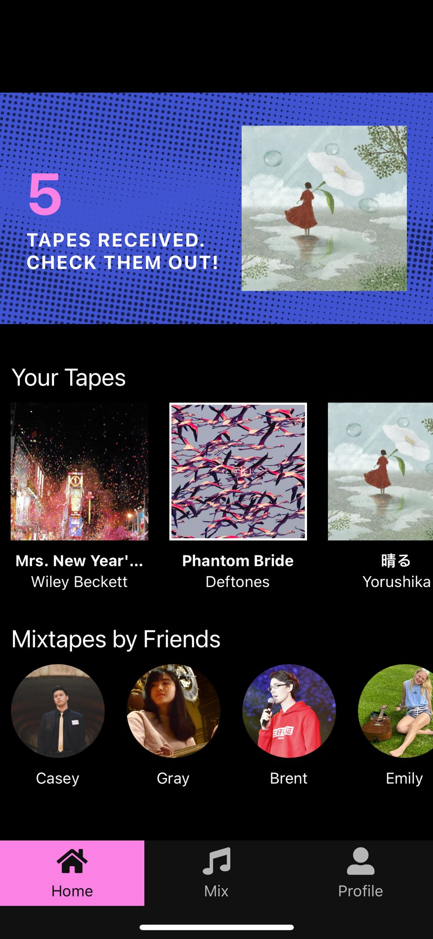
10
V3: Where we are today
MemRemix (V3) emphasizes the social and geo-based experience and focuses on bright, clean, fun UI
Notes:
Emily - Evolution

Slide 11
11
Tasks

Slide 12
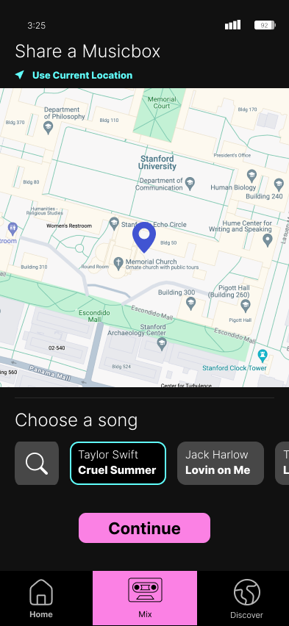
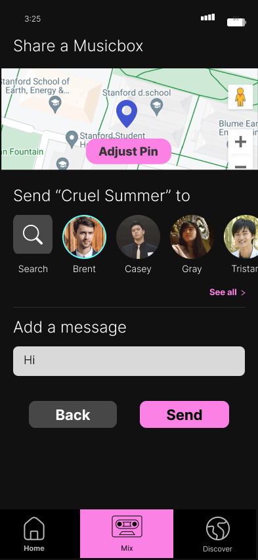
12
Task #1
Gift a tape
Notes:
Emily - Evolution

Slide 13
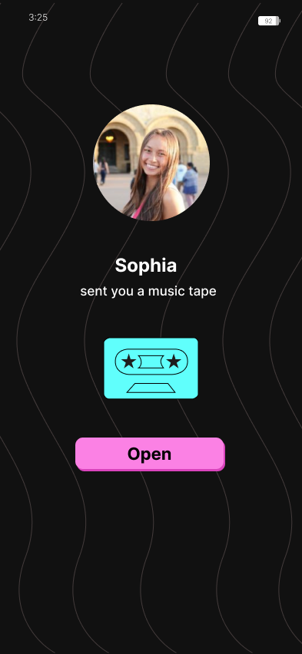
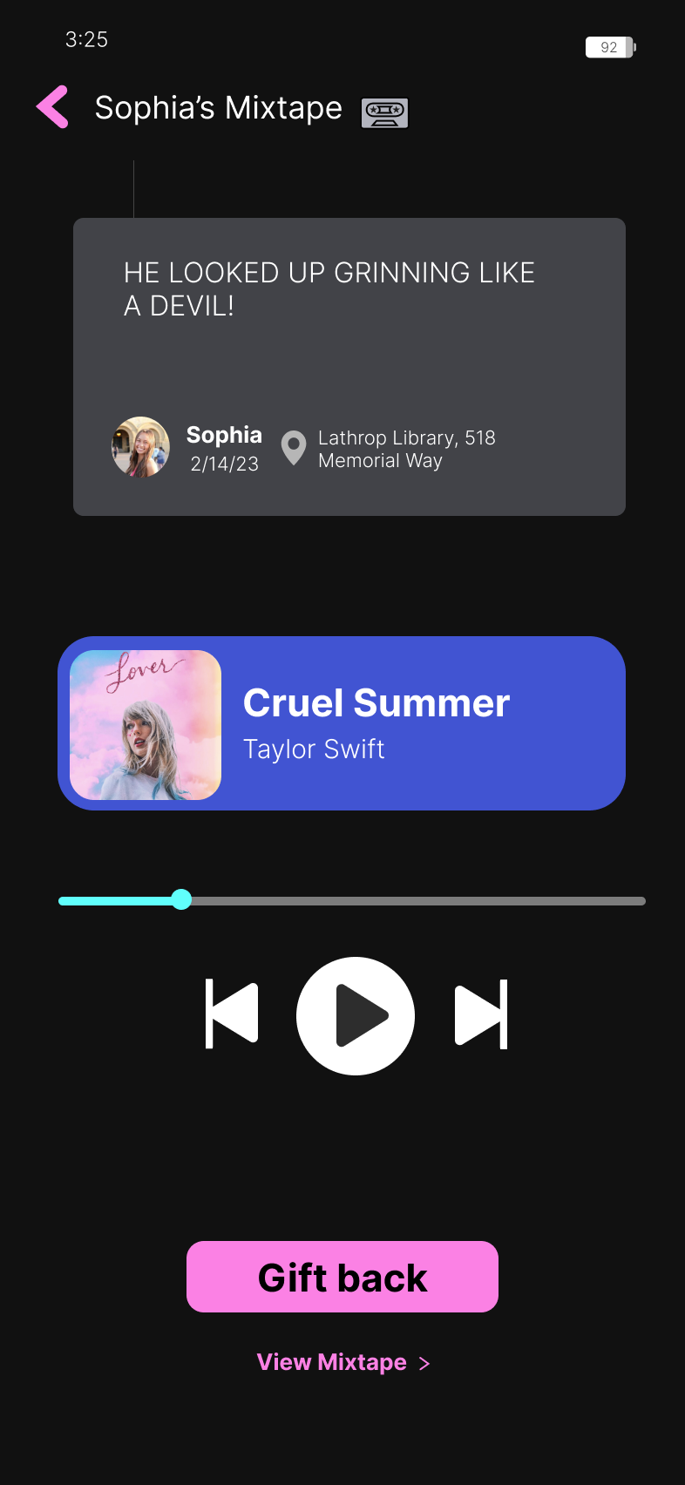
13
Task #2
Receive/play a (mix)tape
Notes:
Emily - Evolution

Slide 14
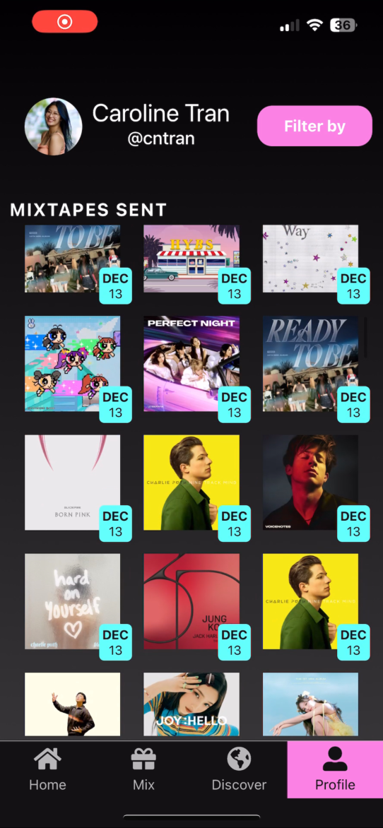
14
Task #3
Revisit music memories
Notes:
Emily - Evolution

Slide 15
15
Implementation

Slide 16






16
Tools
Figma
SupaBase
ExpoGo
React
Spotify
Google Maps
Notes:
Emily - Tasks

Slide 17
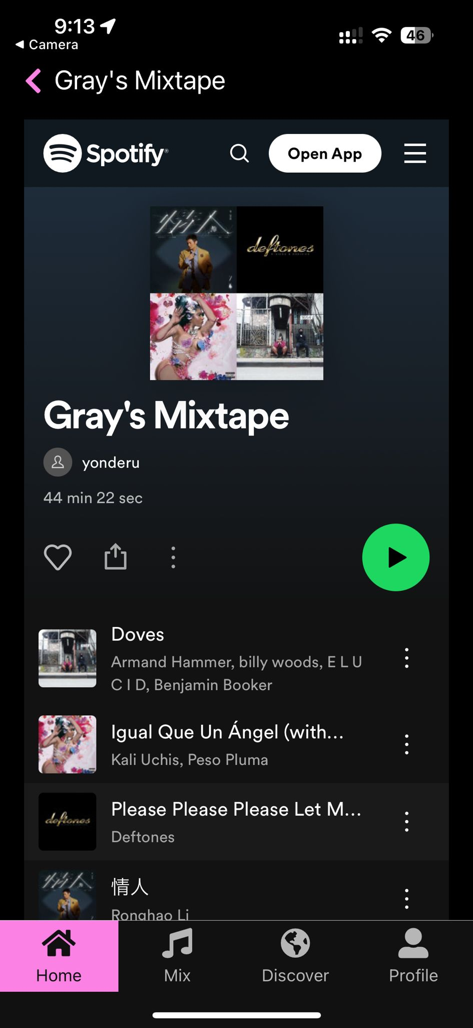
18
Spotify API
1
Connect to Spotify account
2
View songs
3
Search songs
Notes:
Emily - Tasks

Slide 18
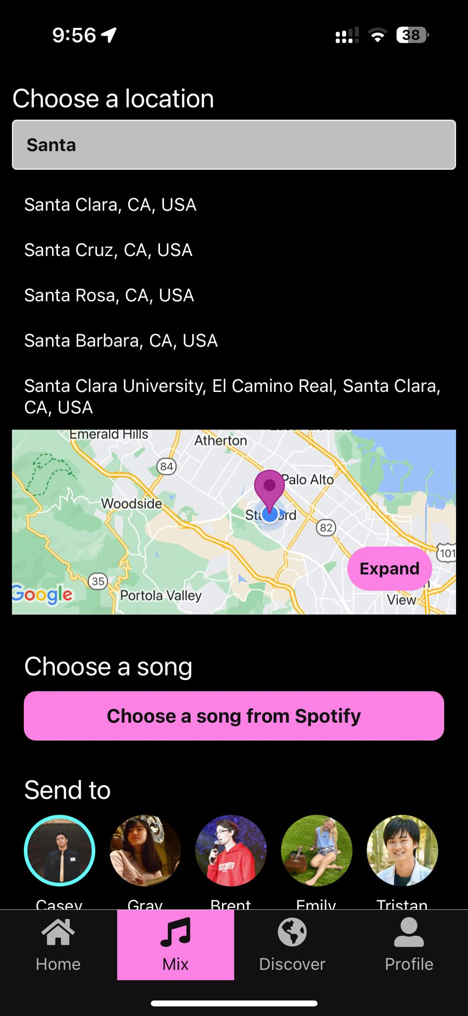
19
Google Maps API
1
Connect to API
2
Adjust pins manually
3
Search locations
4
Send location with tape
Notes:
Emily - Tasks

Slide 19
21
Demo

Slide 20

22

Slide 21
24
What’s Next

Slide 22

25
Future Implementation Work
1
UI Clean Up (Spotify API Limitations)
2
Play complete songs in app
3
Store songs sent in playlists
Notes:
Brent - Future work

Slide 23

26
Future Vision
1
Personalize tapes with photos & videos
2
Community listening stations
Notes:
Brent - Future work

Slide 24
27
MemRemix
Where music and memories mix
Casey, Brent, Emily Grace, Tristan
Stanford CS194H Winter 2024

Slide 25







nurture communities through shared goals
Notes:
Compelling introduction

Slide 26

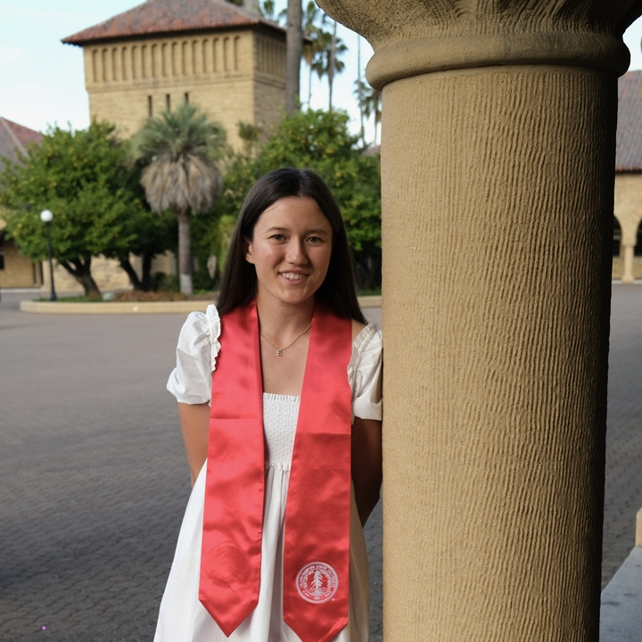
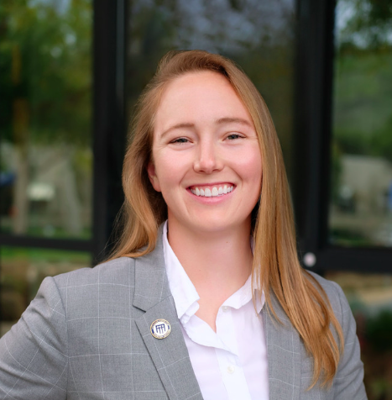
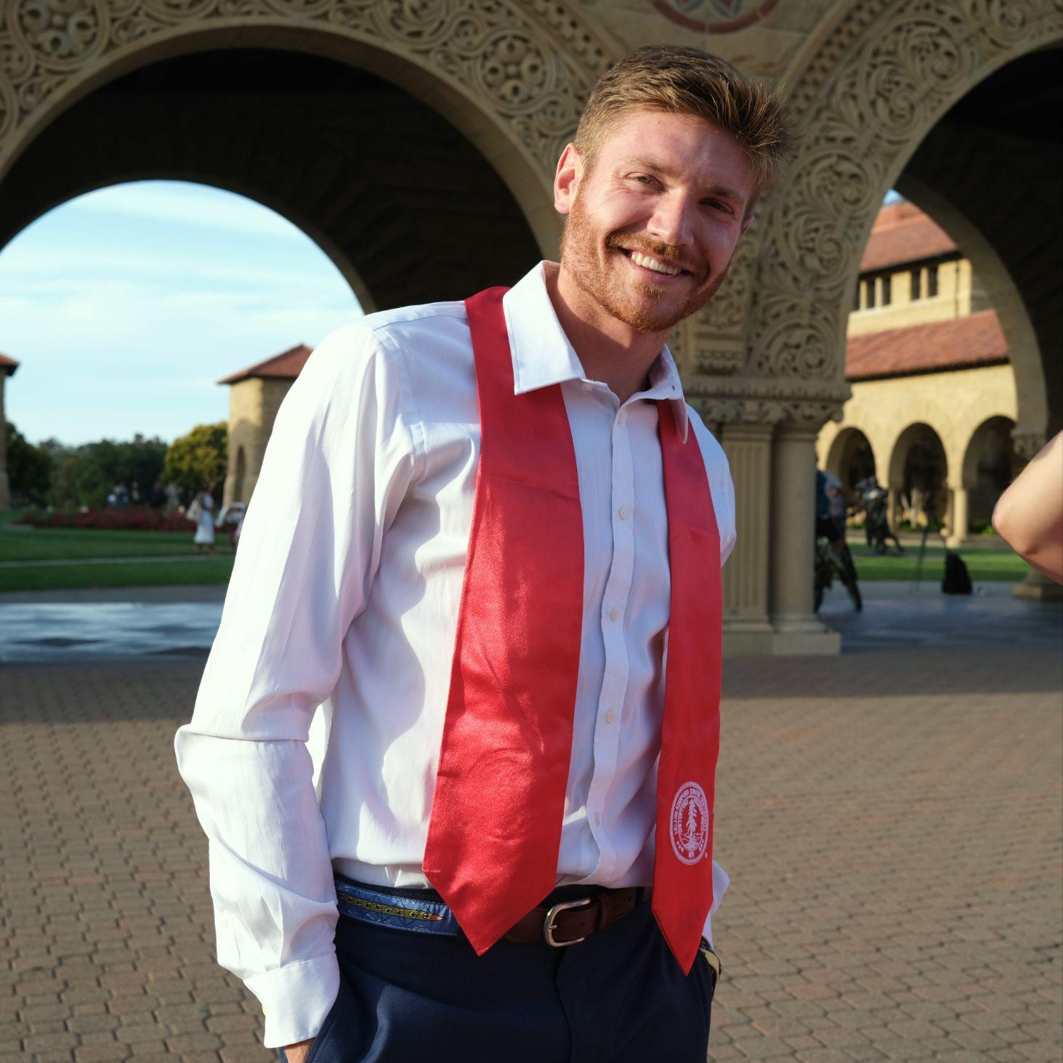
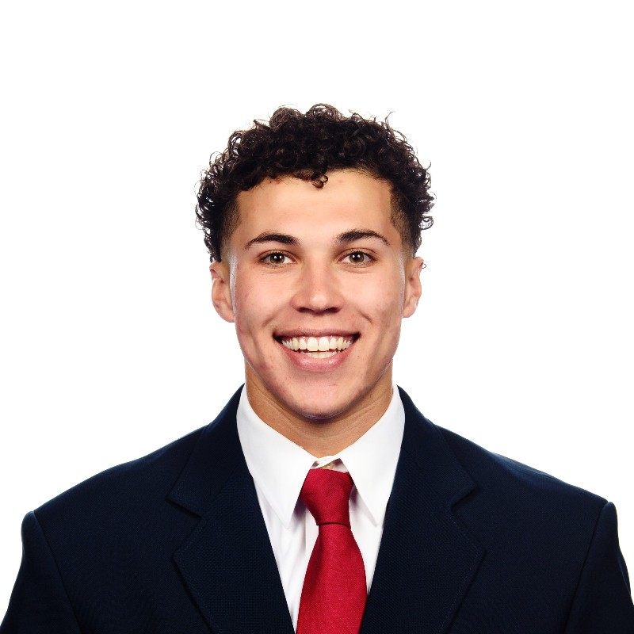
We are an eclectic bunch
Nate
Fleischli
Elysia Smyers
Lyndsea Warkenthien
Jack Clark
Tristan Sinclair
BS CS AI ‘23
MS CS HCI ‘24
BS SYMSYS ‘23
MS CS HCI ‘24
BS CS AI ‘24
BS MS&E ‘23
MS CS HCI ‘24
BS CS AI ‘23
MS CS HCI ‘24
Notes:
Compelling introduction
Team: hook them in; tell a story about yourself–personal, relevant, impressive. Skills.

Slide 27
What to expect
Intro
Problem
Solution
Design Evolution
What We Made
Conclusion
Notes:
Outline of talk
Talk outline: what you are going to tell us in the rest of the talk – tell a story

Slide 28

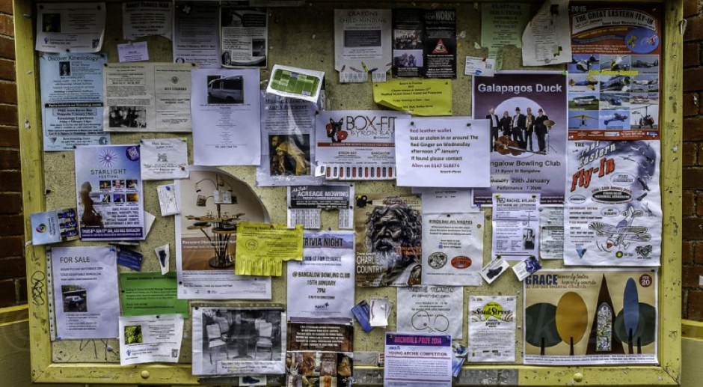
Notes:
Compelling introduction

Slide 29
We discovered a problem
there is a gap between communities needing engagement and individuals eager to support
Notes:
Communities have members who want to contribute to groups outcome goals
High-level problem description
Problem
Problem: what is the user problem being addressed?
Existing solutions: why are these inadequate?

Slide 30
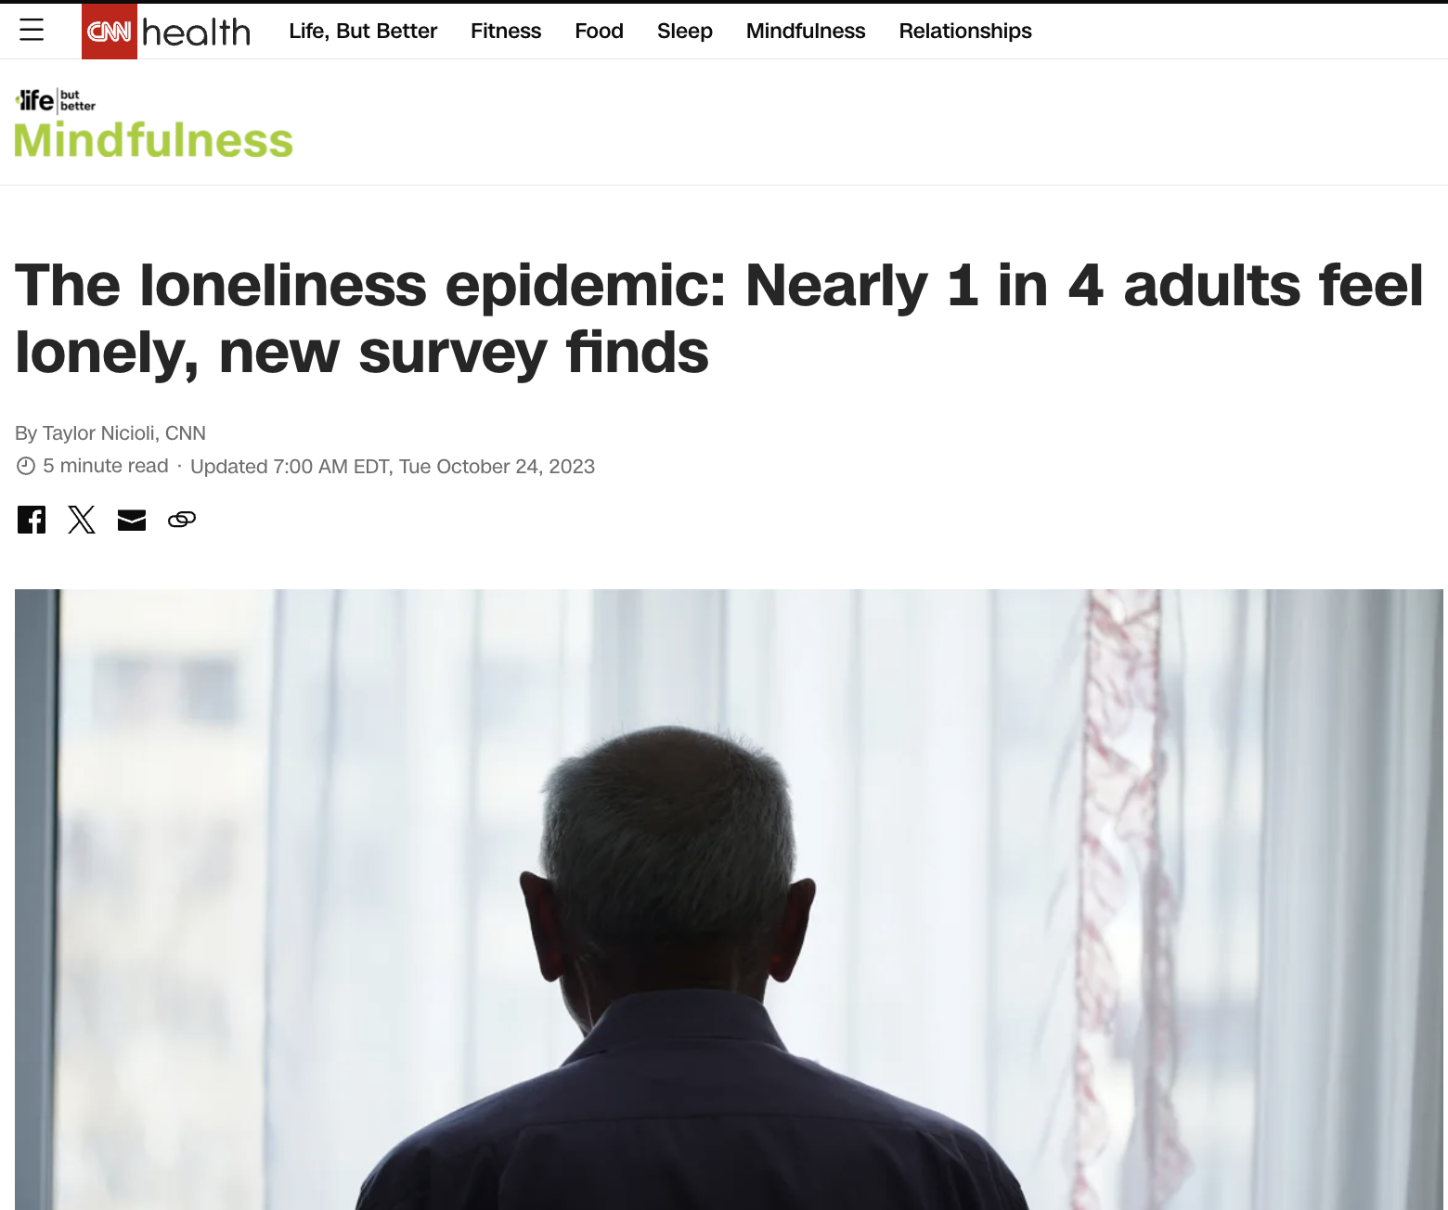
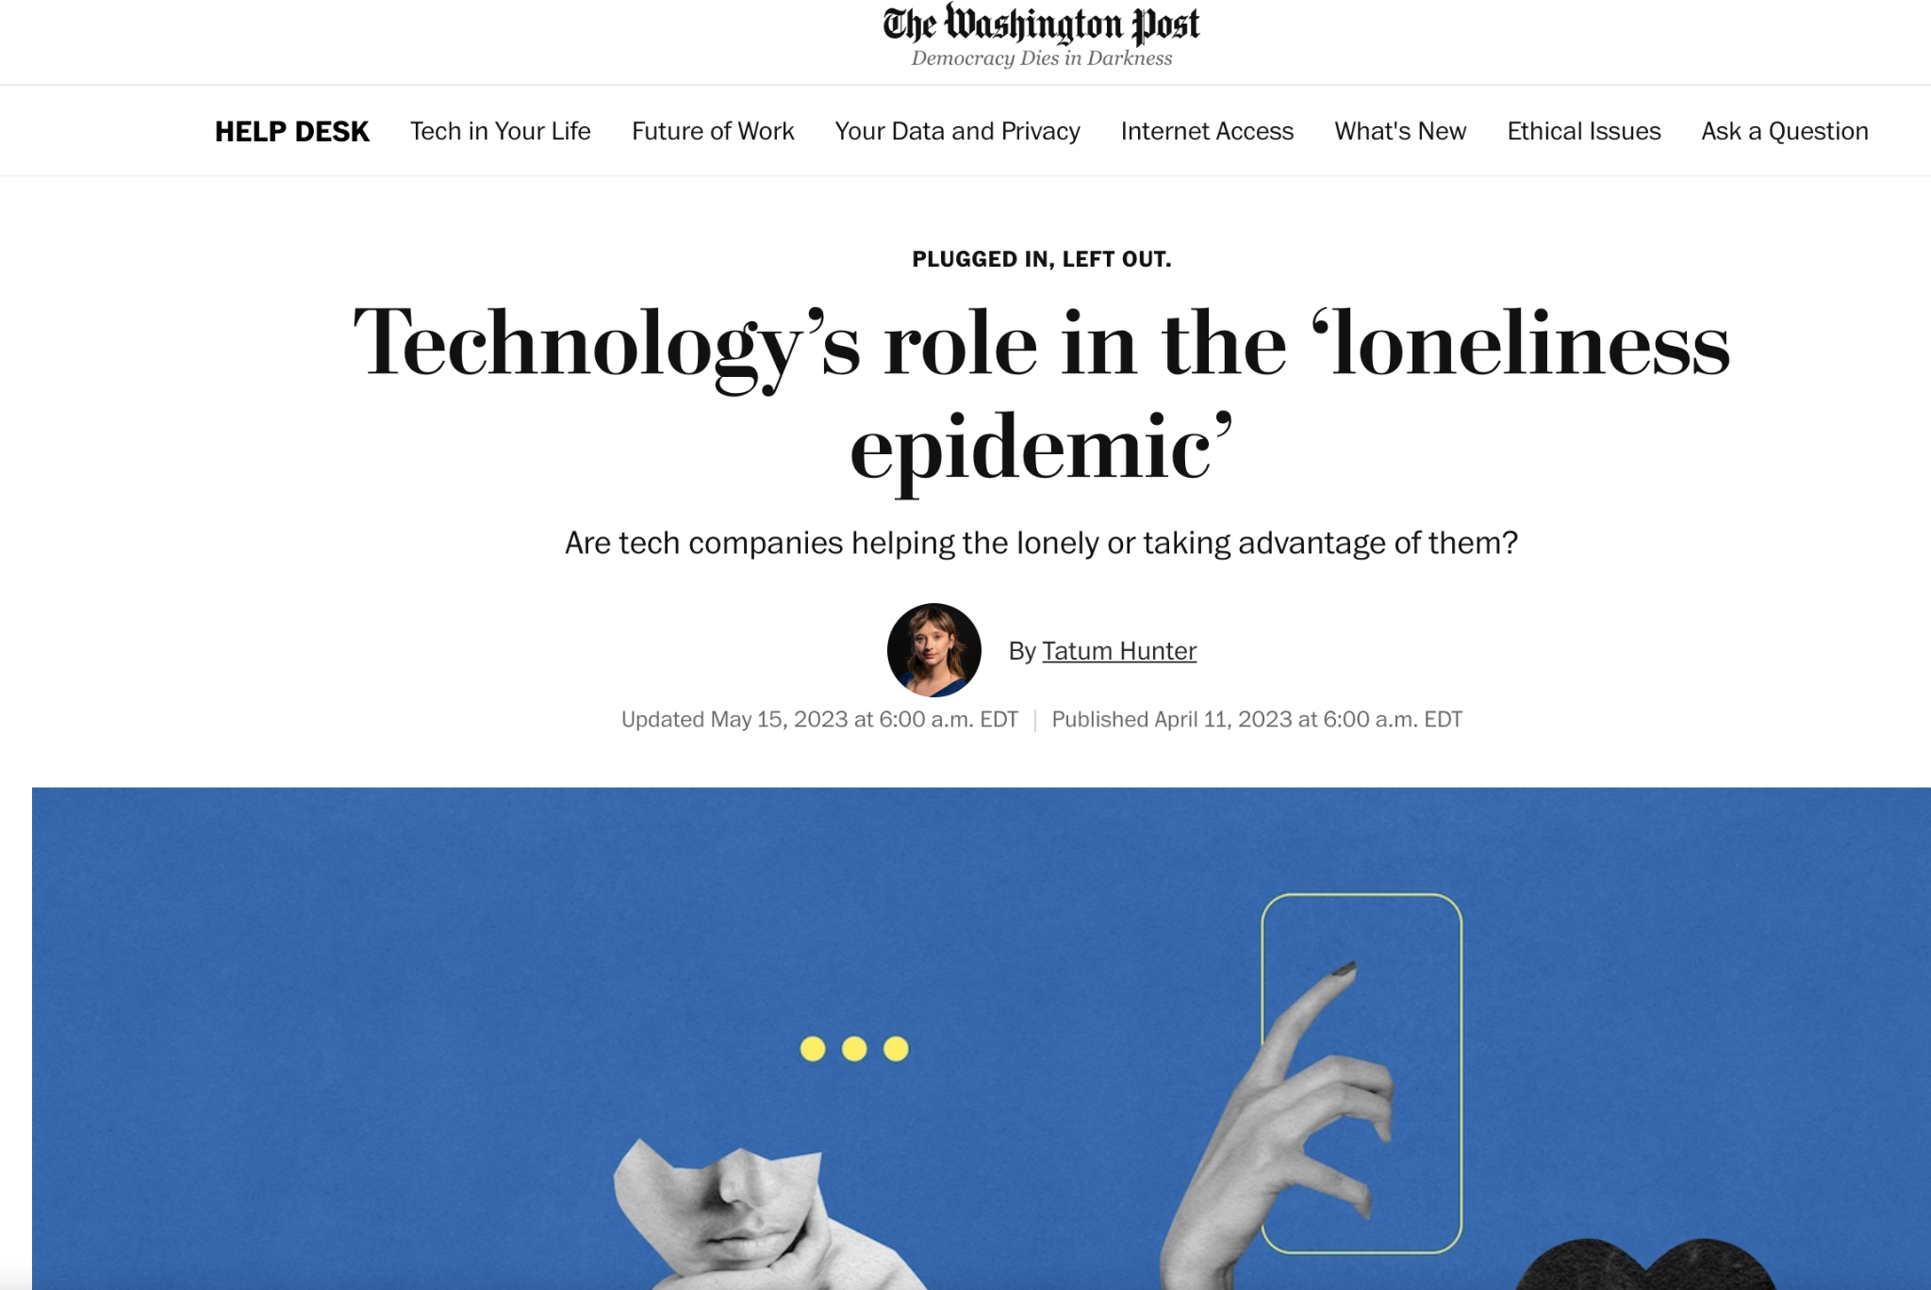
People need community
Notes:
Conclusion: What is your key innovation? What will your key impact on the world be?
https://www.cnn.com/2023/10/24/health/lonely-adults-gallup-poll-wellness/index.html

Slide 31



Currently, nothing solves the problem
Notes:
Existing solutions & why they don’t work
Nextdoor - in practice, used very negatively
Strava - too metric based, focused mainly only running
Apple health - not social enough or accessible - e.g. best usage is with an apple watch

Slide 32
At root, our mission is
bring together communities through new ways to connect, engage, and live
Notes:
bring together communities through new ways to connect, engage, and live

Slide 33
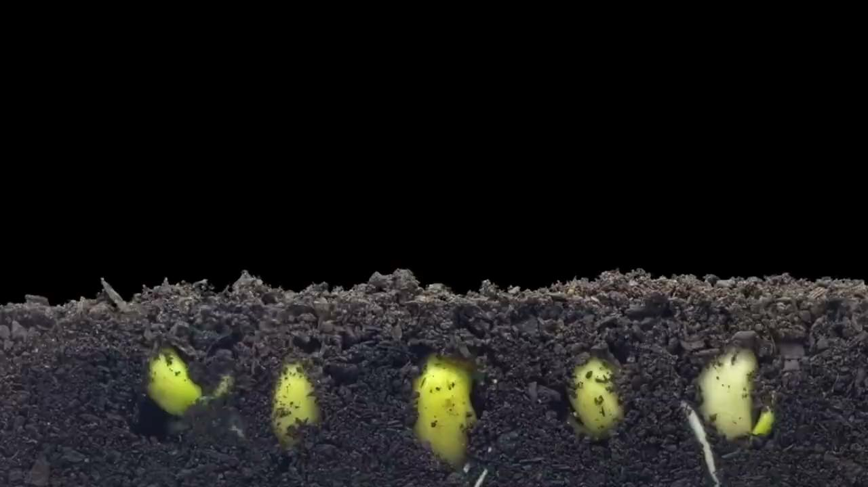
Notes:
Video that fits the narrative

Slide 34
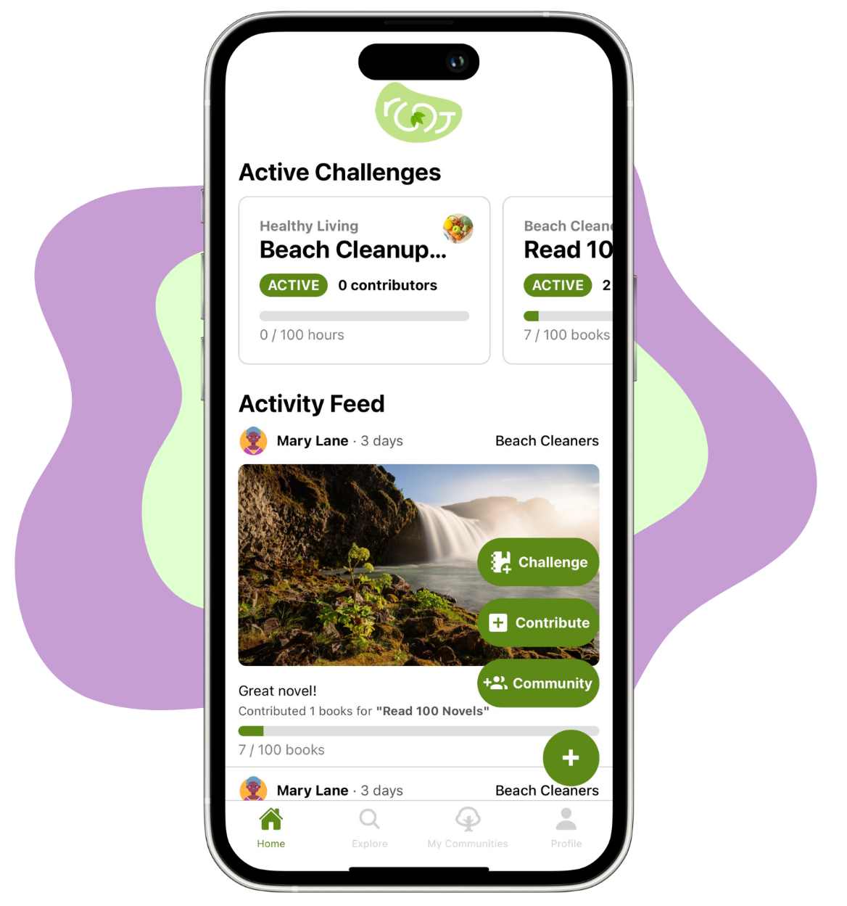
Notes:
HERO SHOT
root connects users and communities through shared challenges towards positive goals

Slide 35



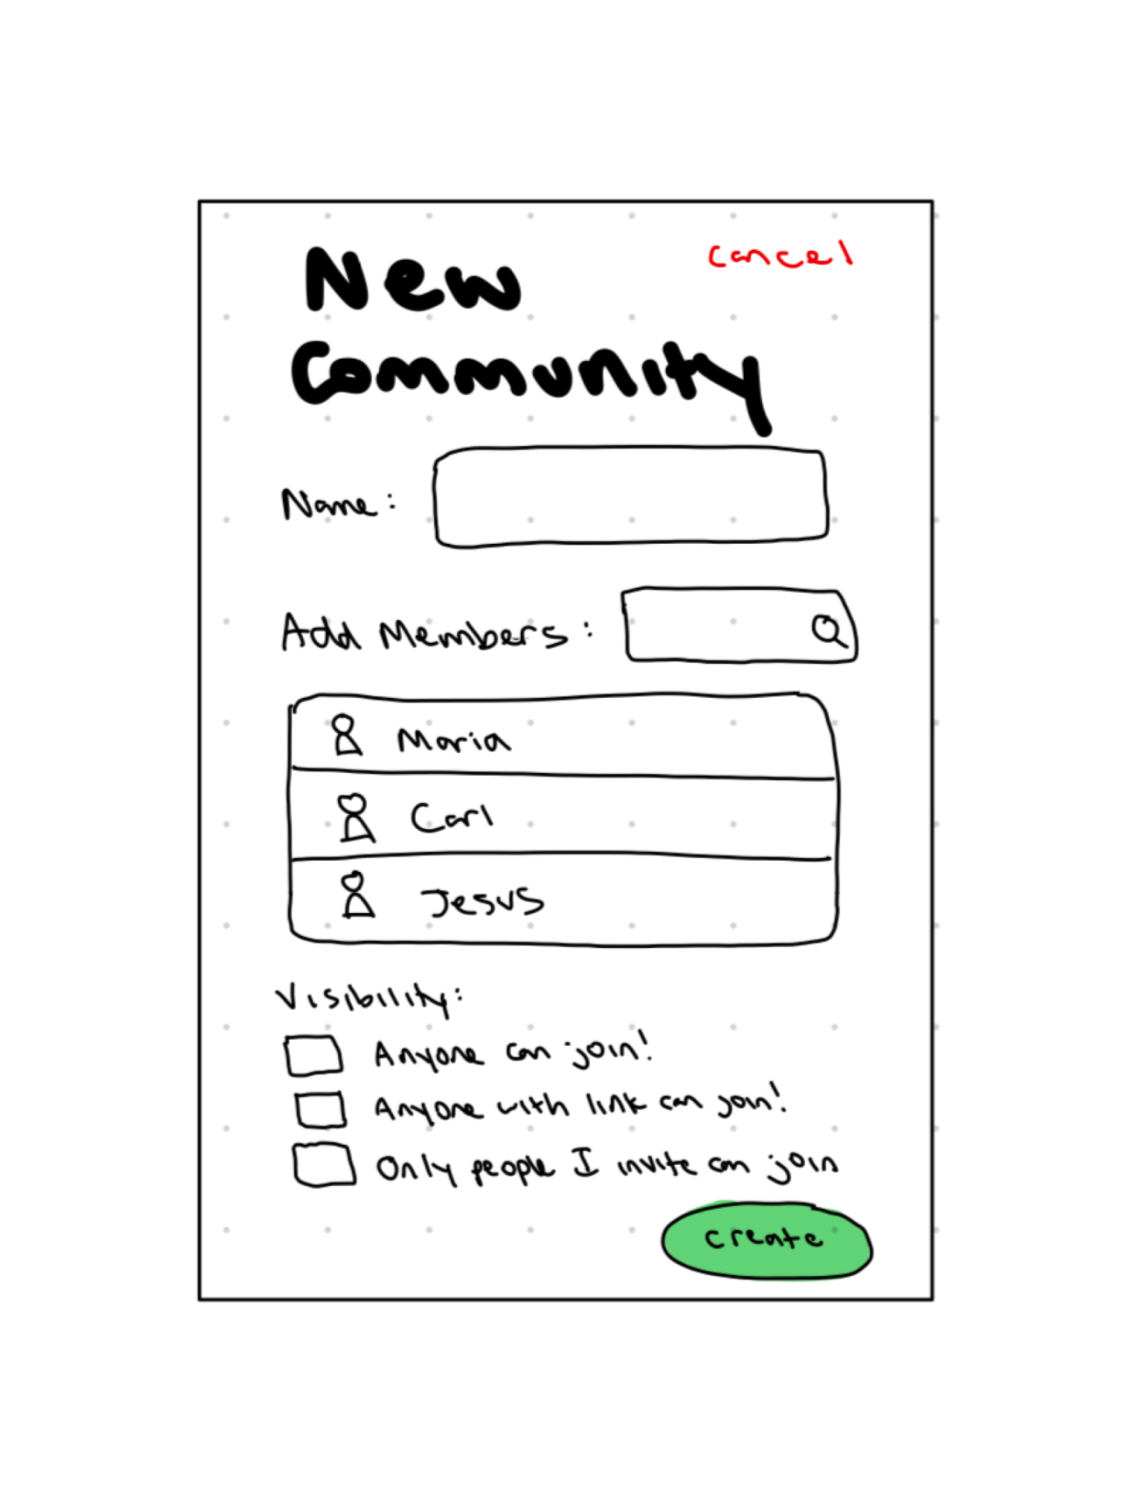
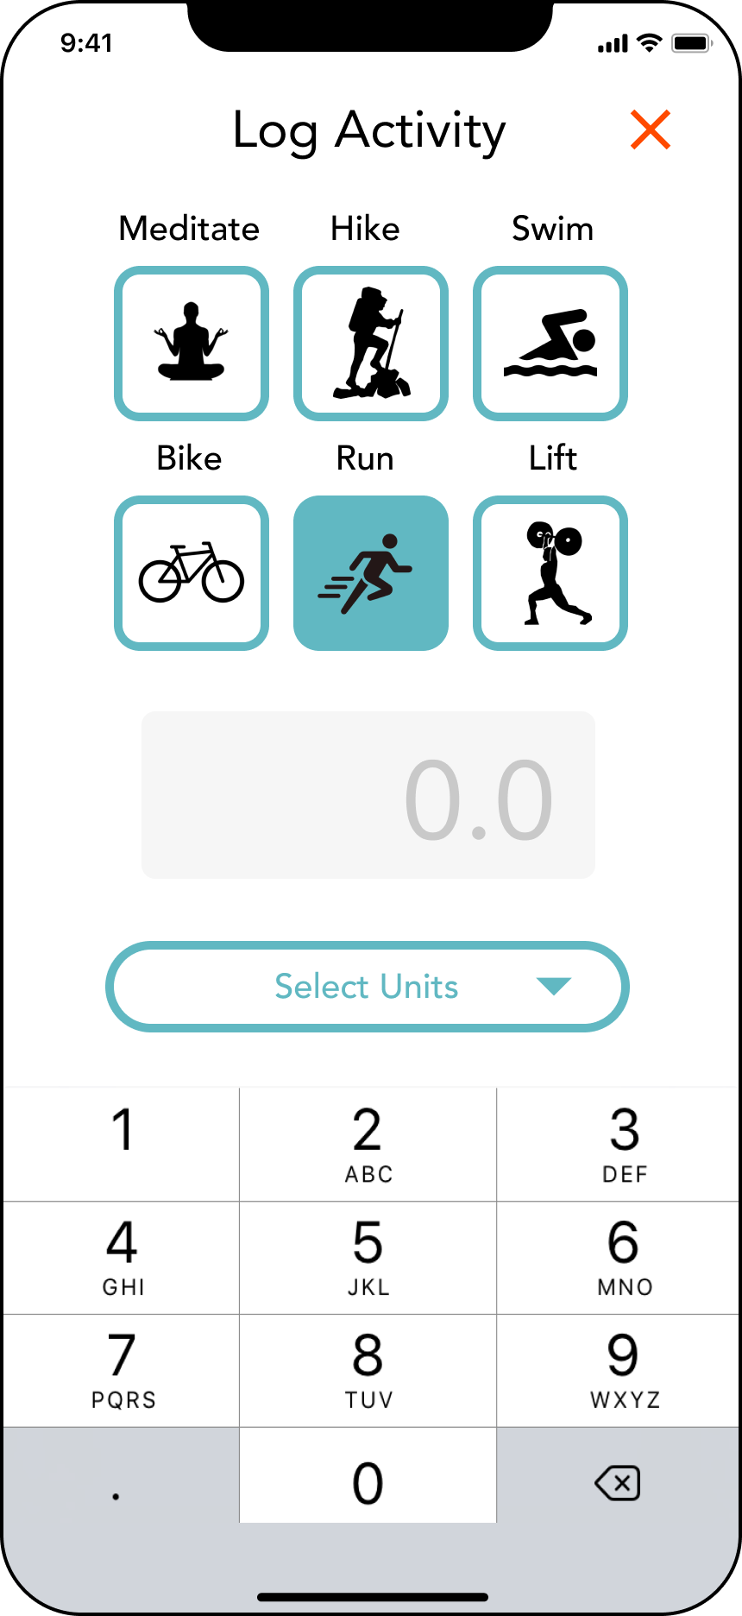
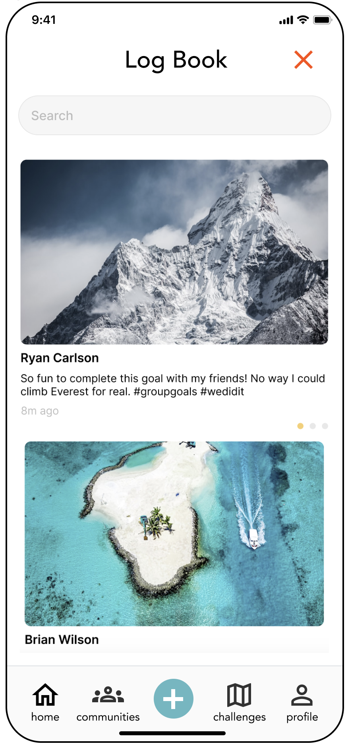
Design evolution - CS147 Fall 2023
Lo-fi sketching
Med-fi mockups
Hi-fi Prototype V1
Notes:
Design Evlolution – Good Coverage
Show major steps covered in both quarters (very brief on 147 stuff)
Explain reasoning, evidence, and implications behind design changes

Slide 36
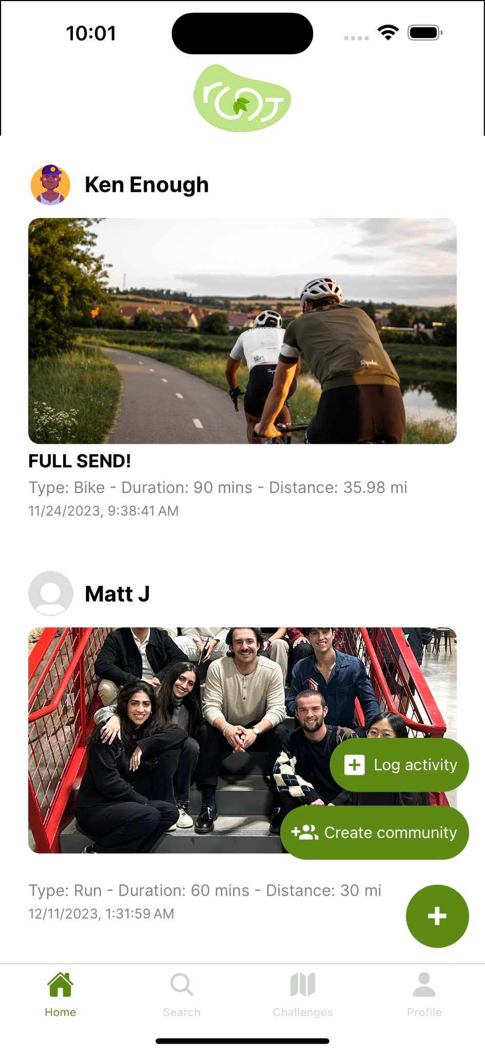
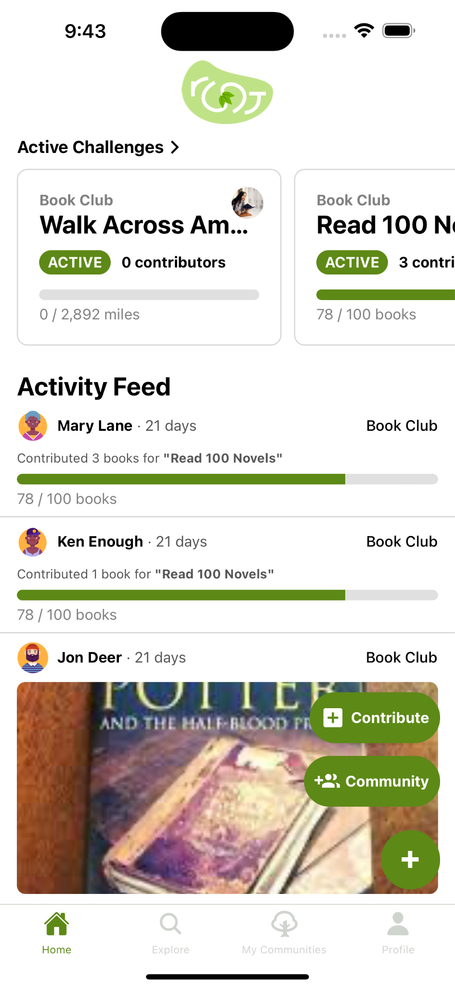
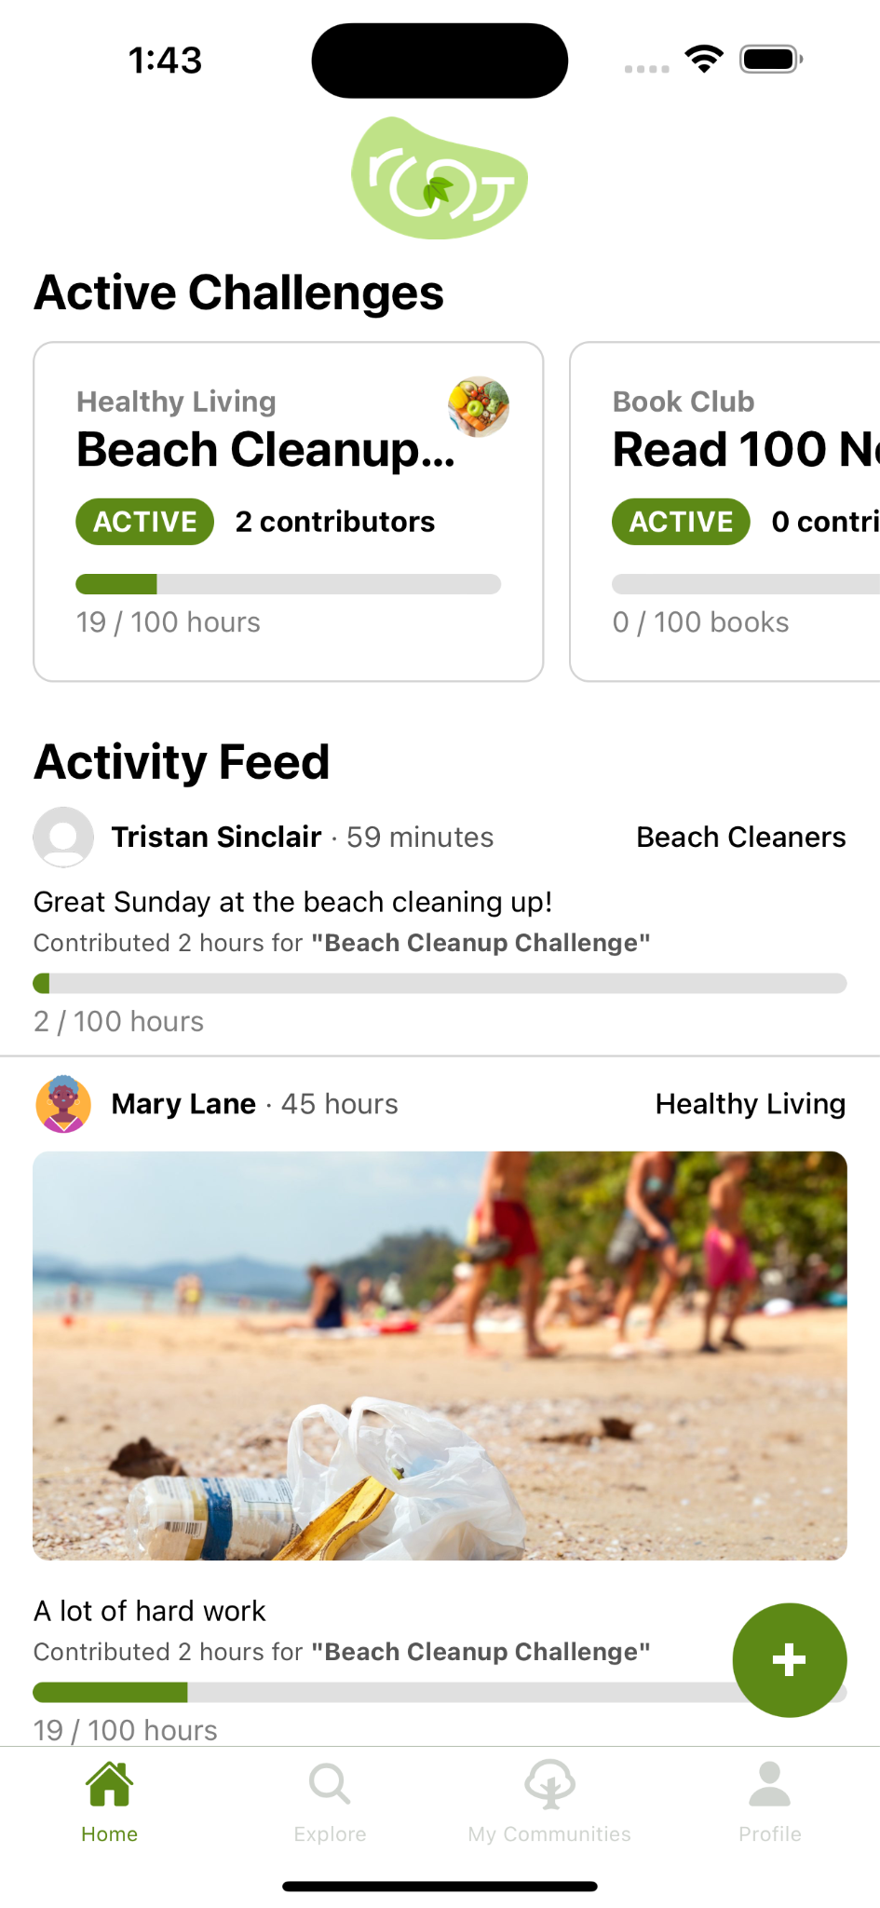

Design evolution - CS194H Winter 2024
Hi-Fi Prototype V2
Hi-Fi Prototype V3
Final Implementation
Notes:
Design Evlolution – Good Coverage
Show major steps covered in both quarters (very brief on 147 stuff)
Explain reasoning, evidence, and implications behind design changes

Slide 37

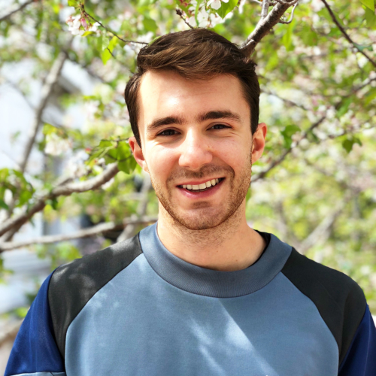
We received some great feedback from experts
Guadalupe Babio
Samsung Staff Designer
Matt Jöerke
Stanford HCI PhD Candidate
Notes:
Design Evolution – Good Coverage
Show major steps covered in both quarters (very brief on 147 stuff)
Explain reasoning, evidence, and implications behind design changes

Slide 38









We interviewed and tested… a lot
Notes:
Design Evlolution – Good Coverage
Show major steps covered in both quarters (very brief on 147 stuff)
Explain reasoning, evidence, and implications behind design changes

Slide 39
The structure of root
Communities
Users join communities and see activity from all communities they are in within their feed
Challenges
Communities join shared challenges to which members contribute
Notes:
Tasks: why chosen, walkthrough/demo
Part of the high level solution description… explain what root actually does

Slide 40

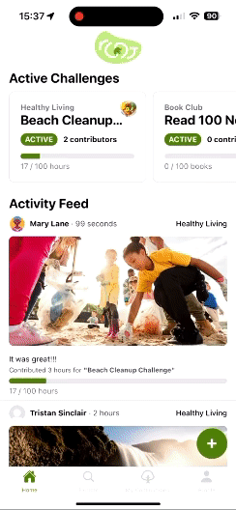
Task 1: Contribute
1
2
3
4
5
6
7
8
Notes:
Our first task is our Contribute function
This is one of the primary functions of our app, the most frequently used path
When a user is ready to contribute to one of their communities goals
They simply hit the Floating action button
Press contribute
Then begin entering information about the task they completed
After lots of testing with this screen and working with out advisors, we landed on a path focused on the units themselves
Here we can see Hours, Books, and Steps offered as options to input
From there, a user can choose the challenge they are contributing to
Filling out the rest of the information

Slide 41
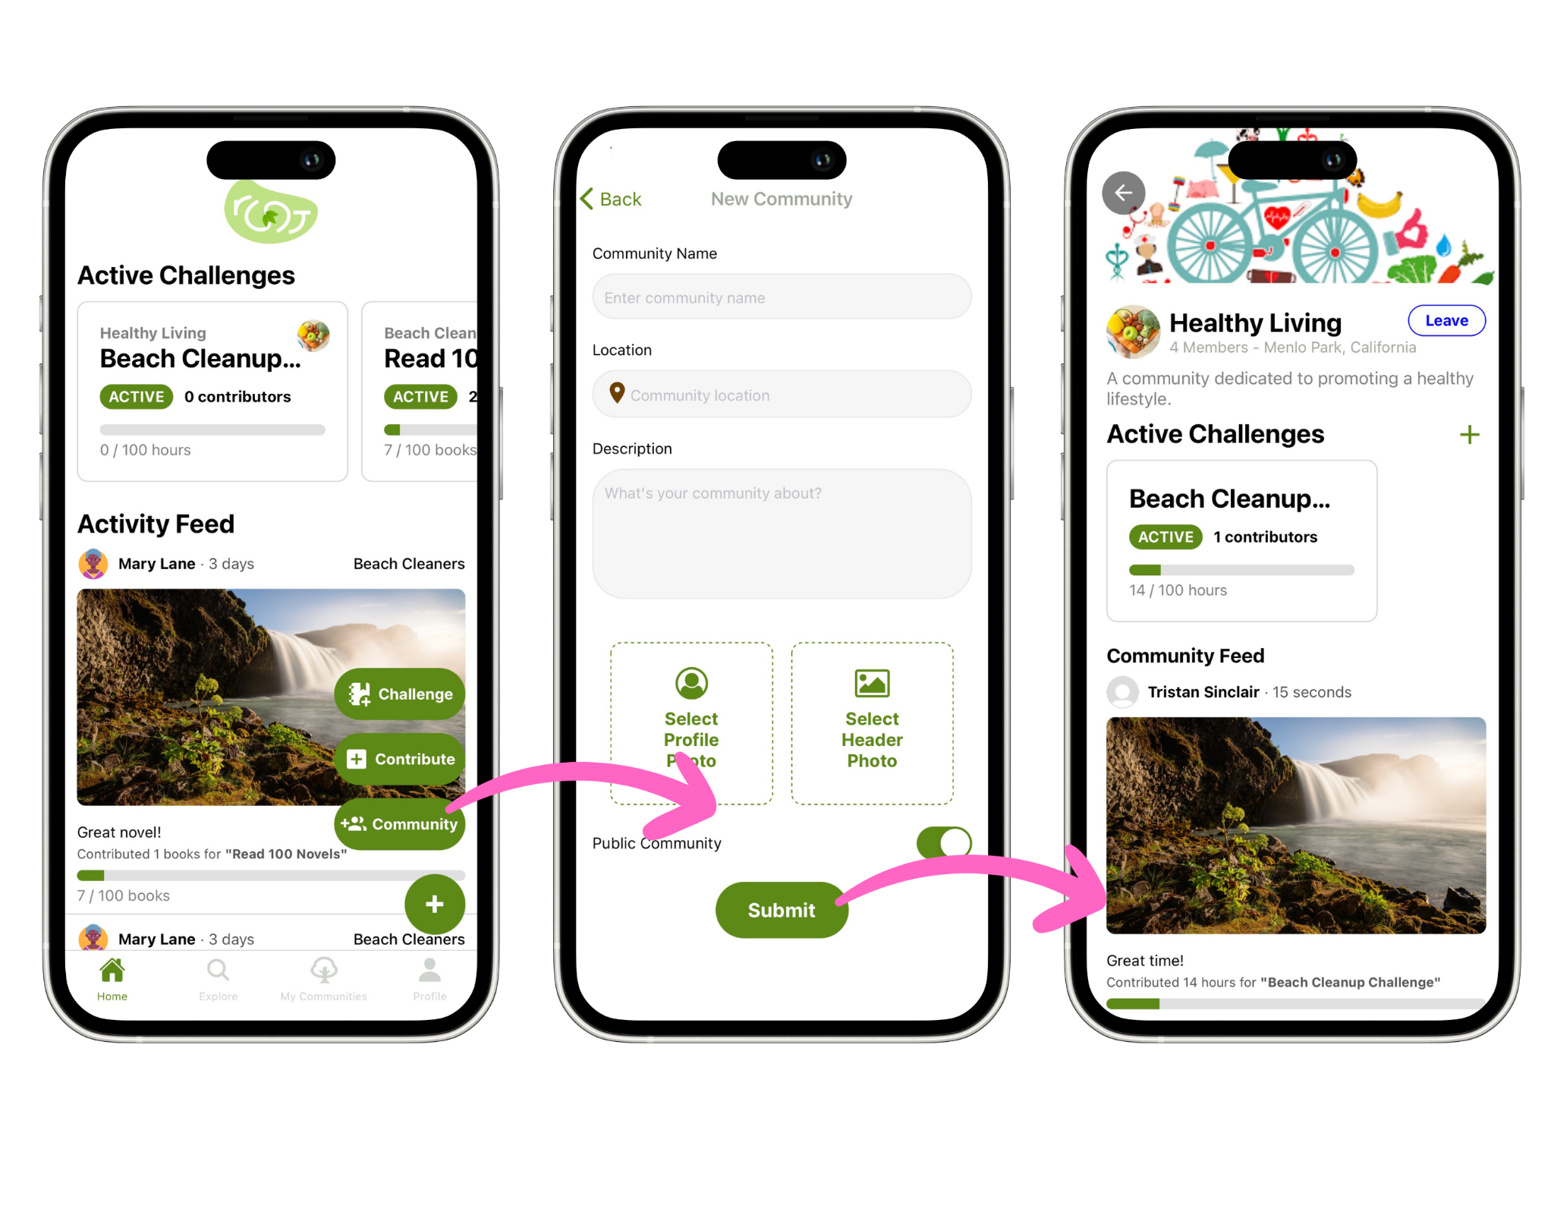
Task 2: Create a community
1
2
3
4
5
6
7
8
Notes:
Next is the create a community function
This is considered a more advanced task, a more experienced user might want to create their own community after being integrated into the app
This action again starts from the FAB
It takes us to this screen, where a user can input the name, location, description and upload a profile and header photo
Then it’s time to get your new members involved and start some challenges

Slide 42
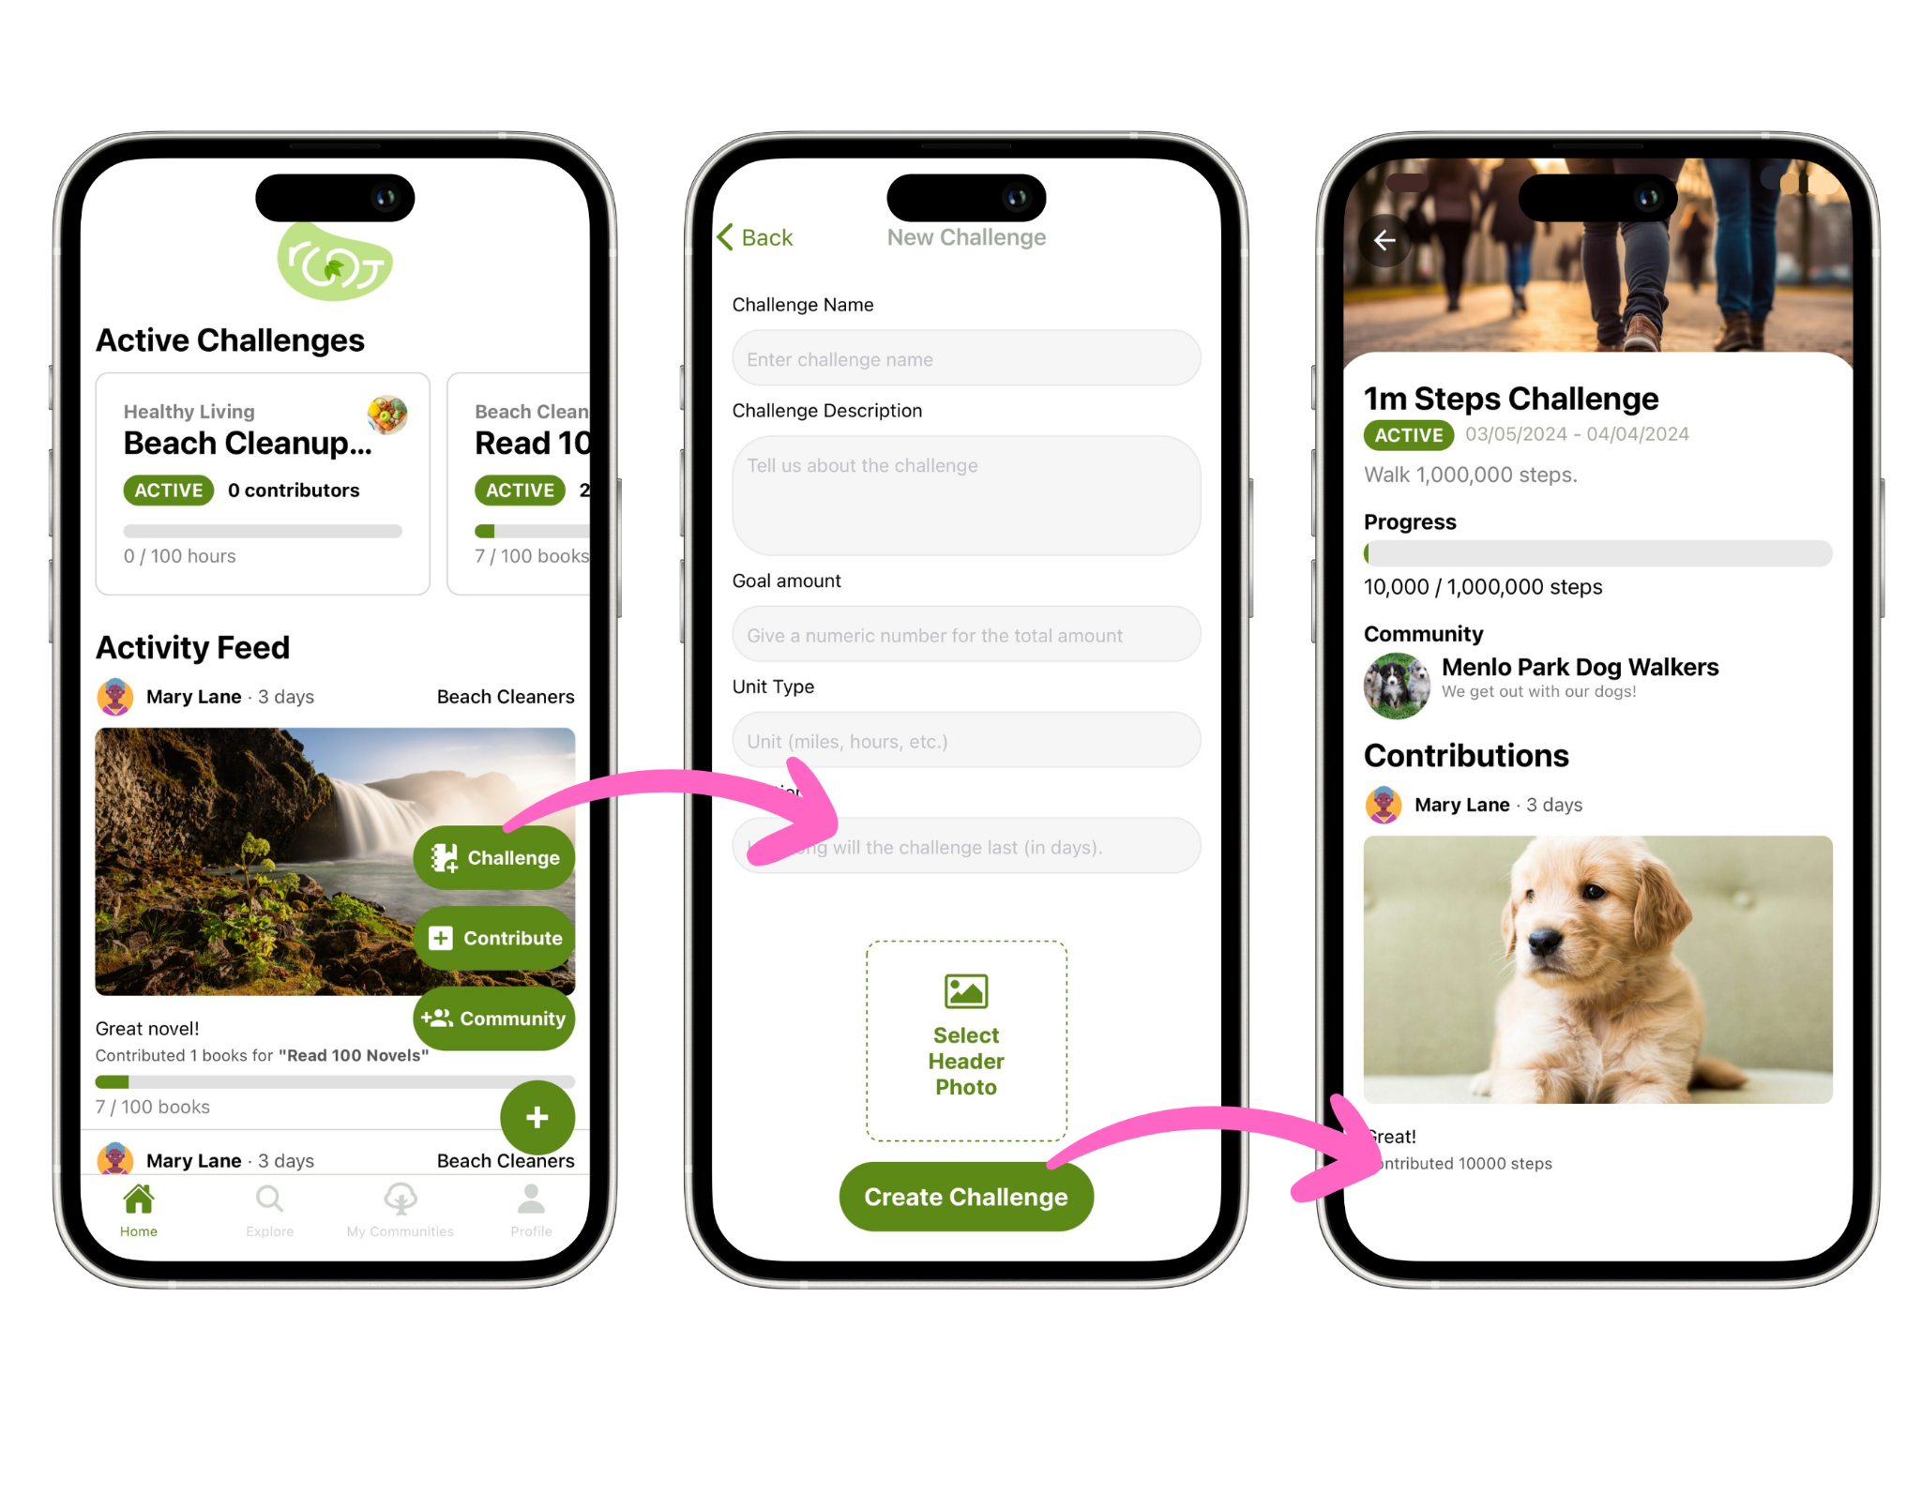
Task 3: Create a challenge
1
2
3
4
5
6
7
8
Notes:
The final task we tested on was creating a challenge
This task is super similar to creating a community, but allows users to create their own custom challenges
This is one of the primary distinguishing features we have that others don’t offer

Slide 43



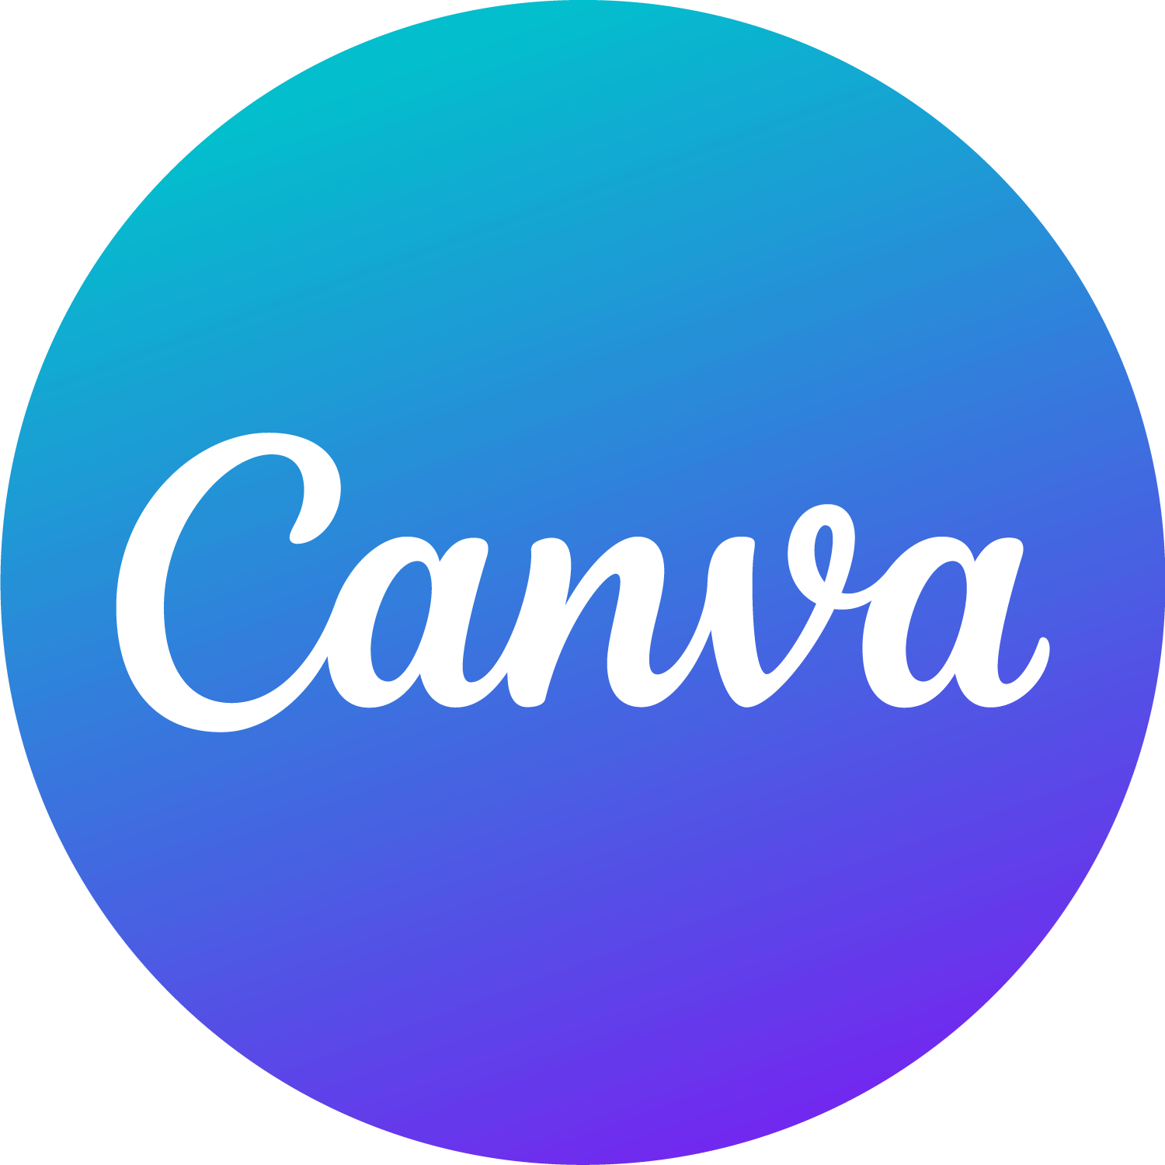
What tools we used
Design
Development
Notes:
Throughout the quarter, we’ve used some awesome tools to help us design, iterate and develop our application
Our primary design tools include: Figma, Canva and Webflow
Our primary dev tools include: Supabase, React Native, and Expo

Slide 44
Some things root is missing
Increased community permissions
Overall more customization capabilities
Robust chat capabilities
Notes:
Missing aspects - not many
Allow for more rankings in communities like admins, moderators, etc
Internal chat for communities - compete with facebook groups
More customization - editing posts/logged activities, editing profile, editing community names

Slide 45
Looking forward towards the future
Verification of contributions to challenges
User authentication improvements and security
Backend speed
Notes:
Potential future enhancements:
Way to verify contributions
Server speed - upload times are very slow
More password safety and rules, ability to logout, 2 factor authentication, etc.

Slide 46
Our key innovations
Playful
Low stakes
Health promoting
Notes:
Conclusion: What is your key innovation? What will your key impact on the world be?
We make a low stakes and playful way to improve physical, mental, and community health

Slide 47
The impact of root
Connecting real-world communities through wholesome and offline engagement
Notes:
Conclusion: What is your key innovation? What will your key impact on the world be?
We think we can make an impact on the overall sense of community in the world

Slide 48
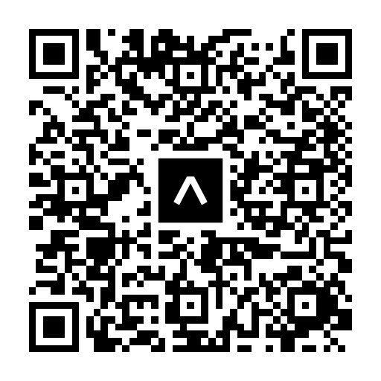
nurture communities through shared goals
Lyndsea G Warkenthien | Elysia Q Smyers | John H Clark
Nate J Fleischli | Tristan A Sinclair

Slide 49
nurture communities through shared goals

Slide 50
Check out the app…
mary@test.com
test12
Notes:
Compelling introduction

Slide 51
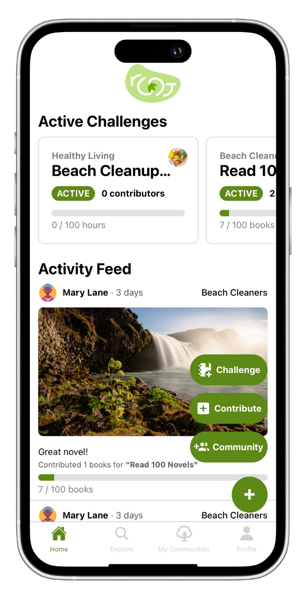
Nate
Fleischli
Elysia Smyers
Lyndsea Warkenthien
Jack Clark
Tristan Sinclair

